Slide 1
Doodle Jump
Stejara Dinulescu

Slide 2
Concept/Motivation
In a GAN that works with images, what is the relationship between input and output?
How do different inputs change the outputs?
More specifically, does the way in which the input was created affect the output (i.e. general trends, what is more visually interesting, etc.)?
How can I push the output so that it can stand alone as Art
Context/controversy about ownership + GANs
Can digital images produced by a machine be art?

Slide 3
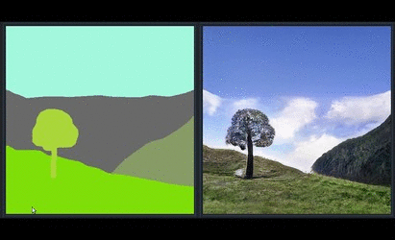
Initial motivating questions/issues
What GAN can I use that best allows me to explore my above questions?
How do I work with this GAN?
Pre-trained? Train my own? Make my own algorithm?
Chose pre-trained GAN, SPADE-COCO, in RunwayML
Takes abstract images and converts it to real-life objects
RunwayML allows for easy working with GANs
What should I give as input to get interesting output?

Slide 4
Process: Exploring Input -> Output and HCI
Relations between inputs and outputs are explorations of different pathways of human-computer interaction
Physical drawings (human -> computer)
Digital drawings
Using Notes application on my iPhone (human/computer -> computer)
Using Drawing Manager (human -> computer -> human /computer -> computer)
Drawing Manager Library made by Jennifer Jacobs
Extensions of Drawing Manager Library made by Stejara
Plotter drawings
Digital drawings (human/computer -> machine -> computer)
Digital code in Processing (human -> computer -> computer)
Digital code in Processing (human -> computer -> computer)
Later question: how does pre-processing of an image affect an output (addition of another “computer” pathway)?

Slide 5
Hand-drawn inputs

Slide 6
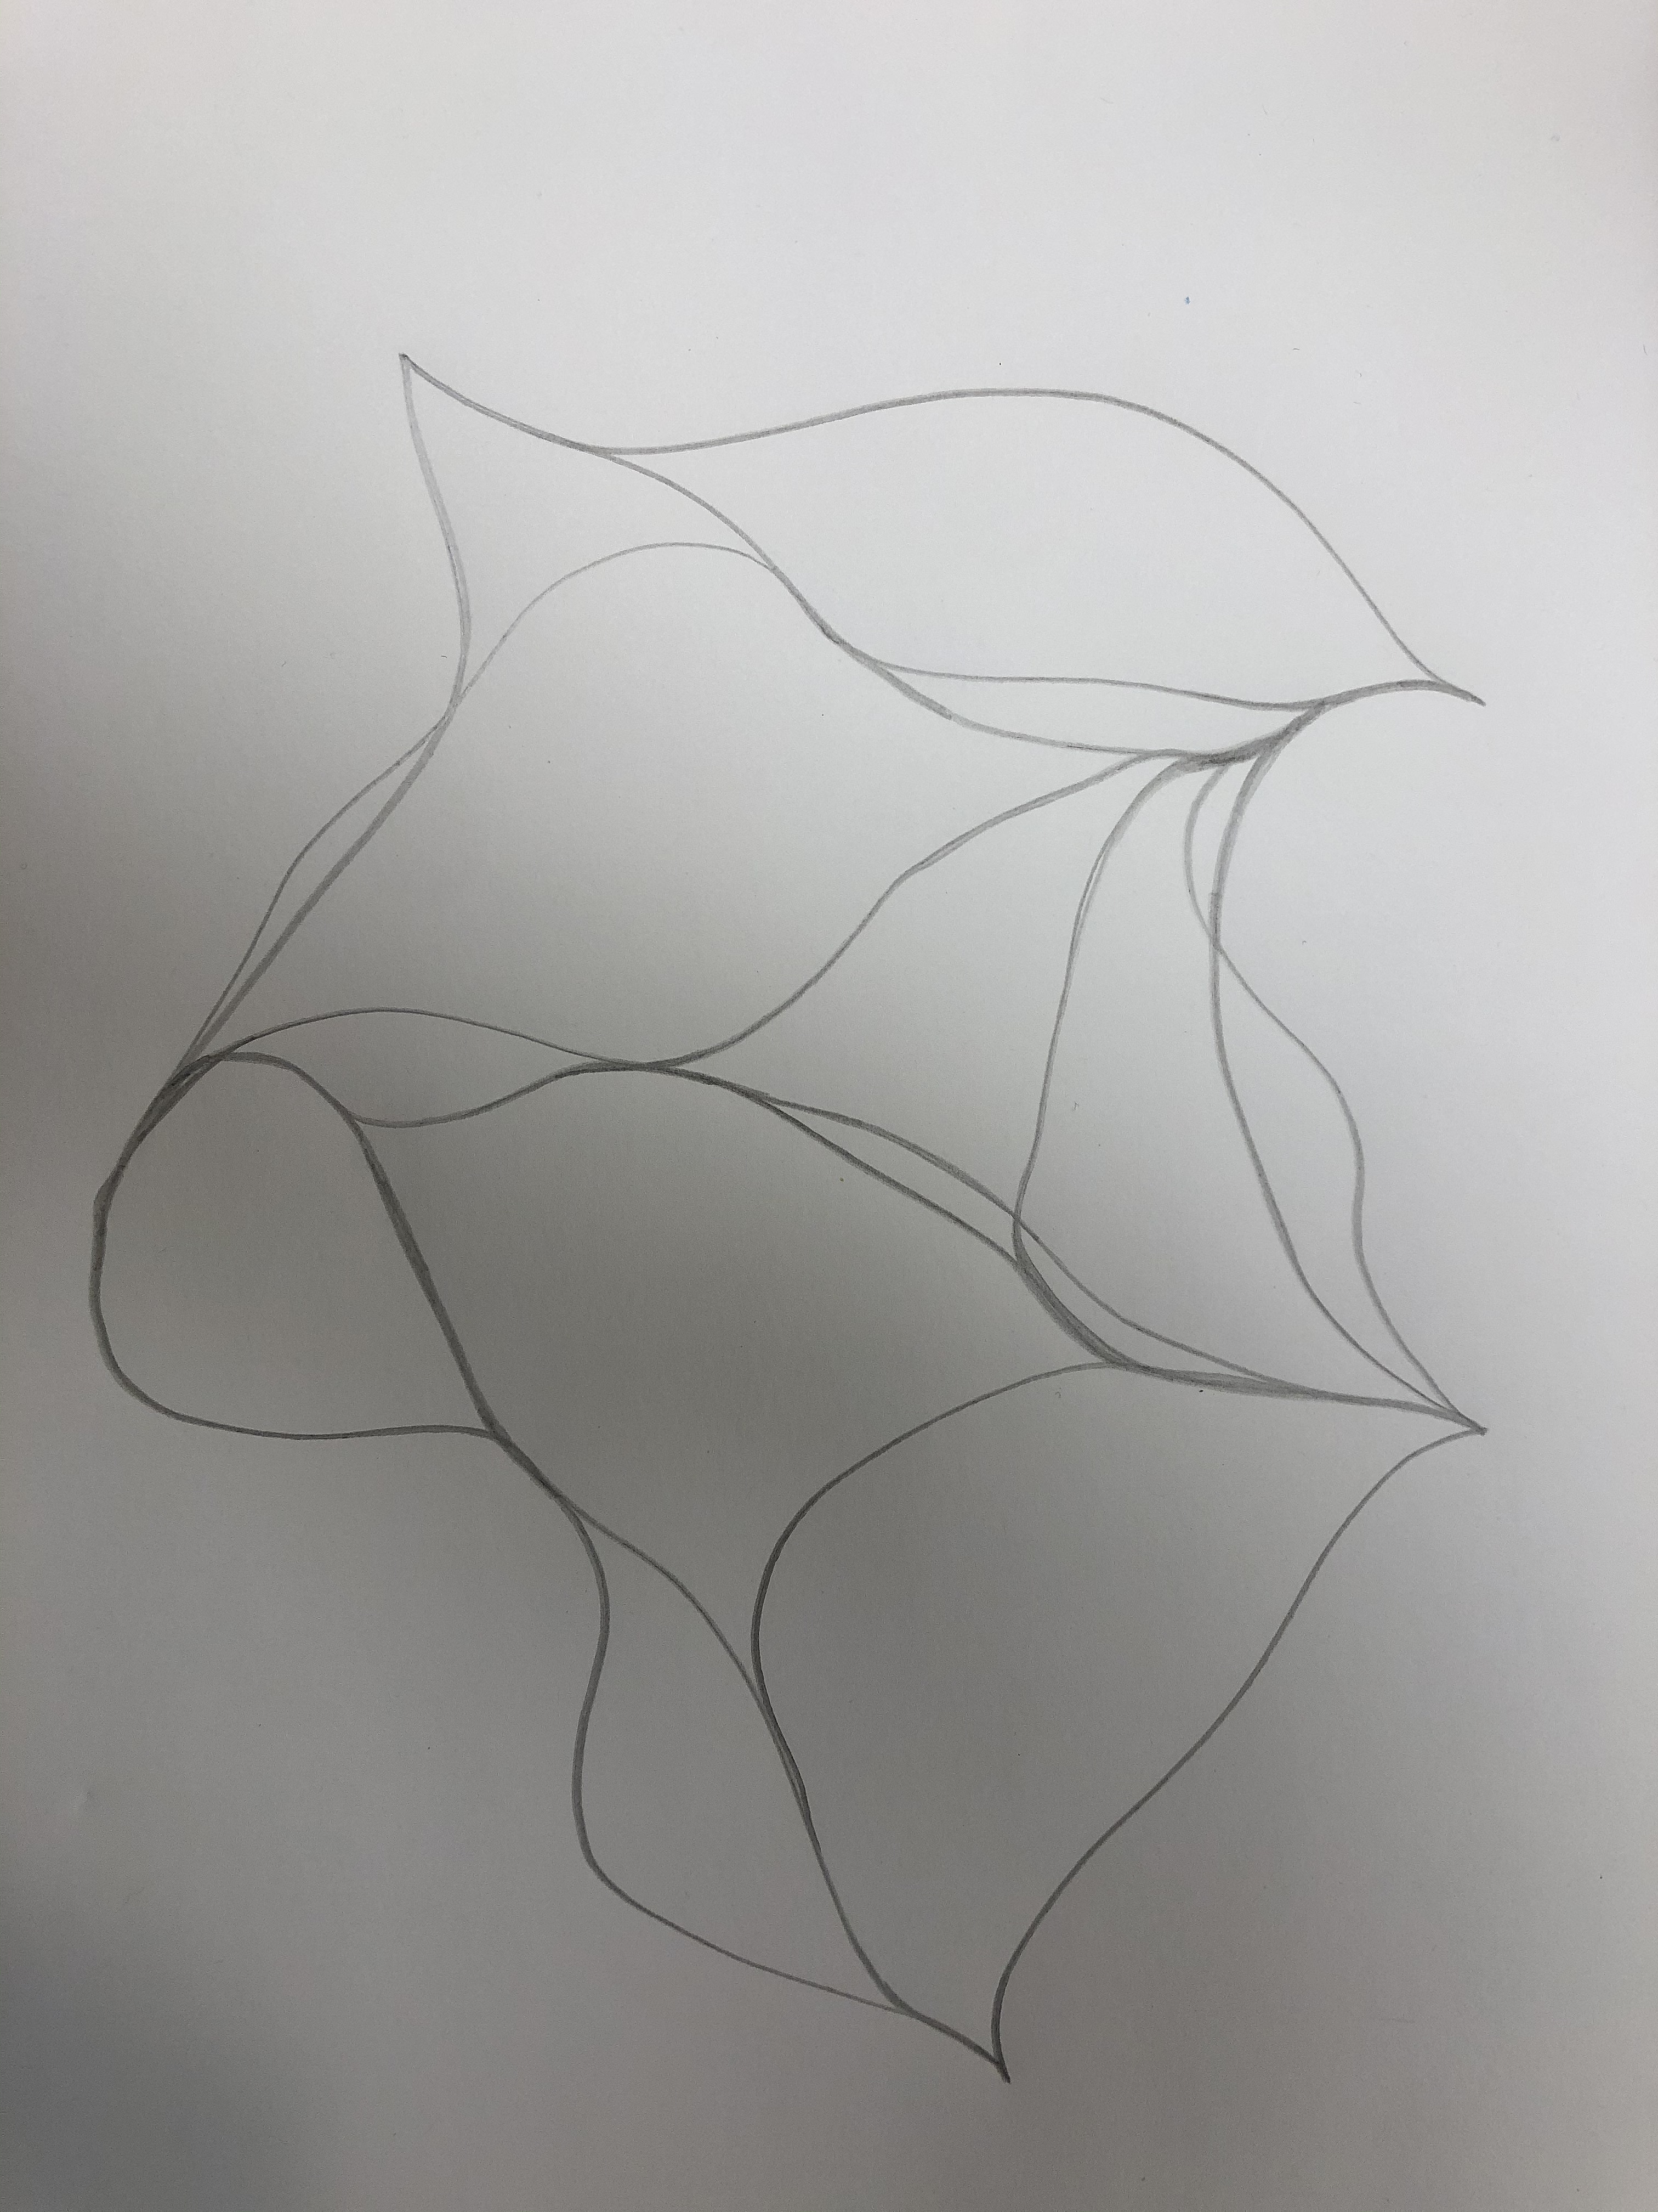
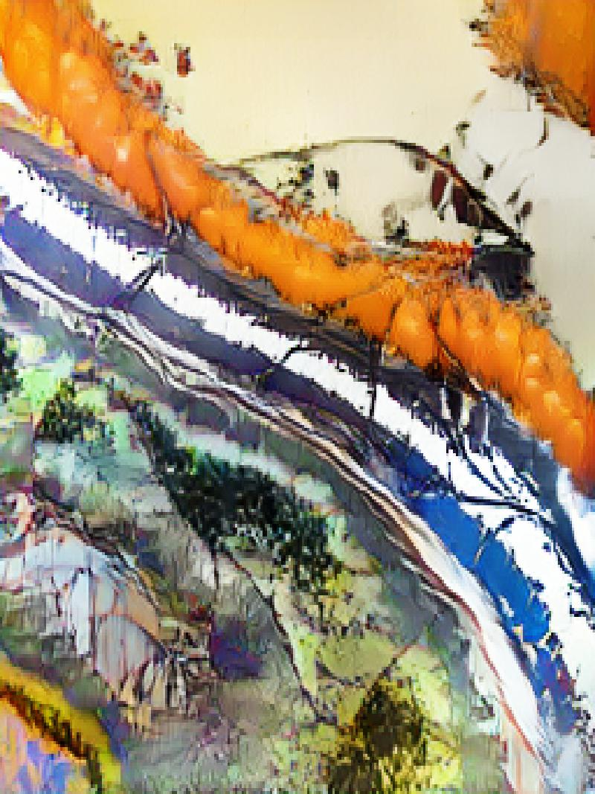
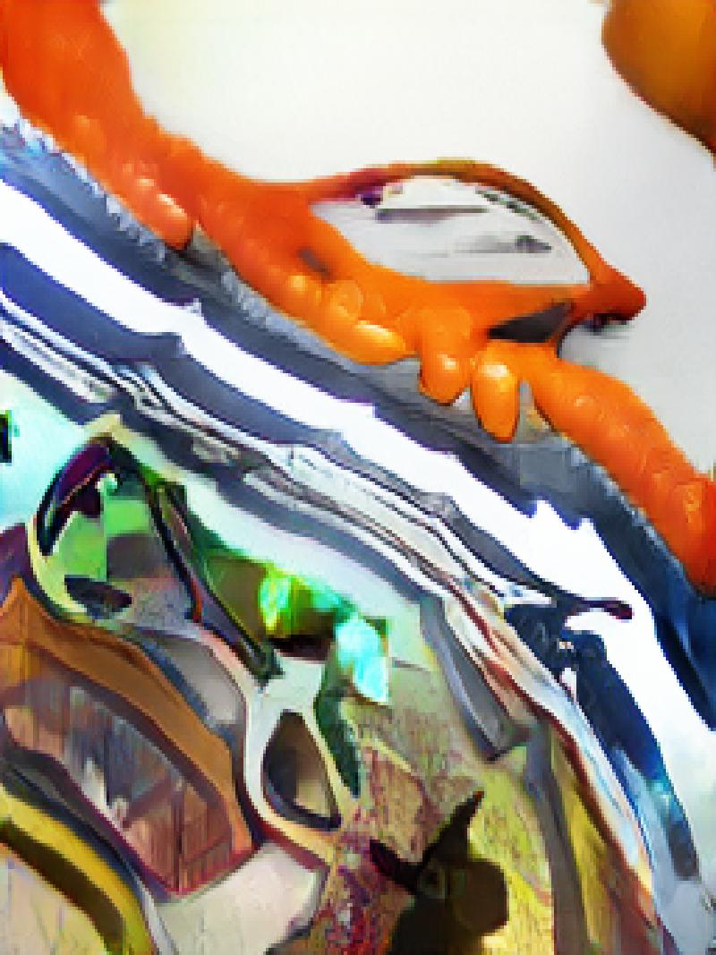
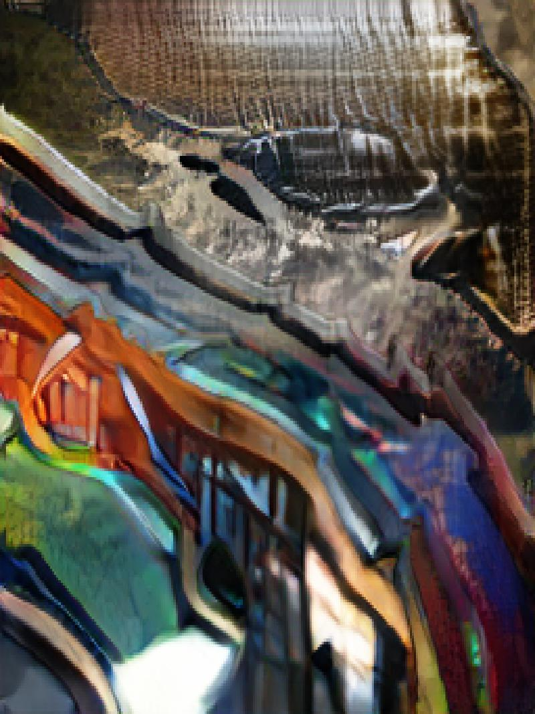

Slide 7
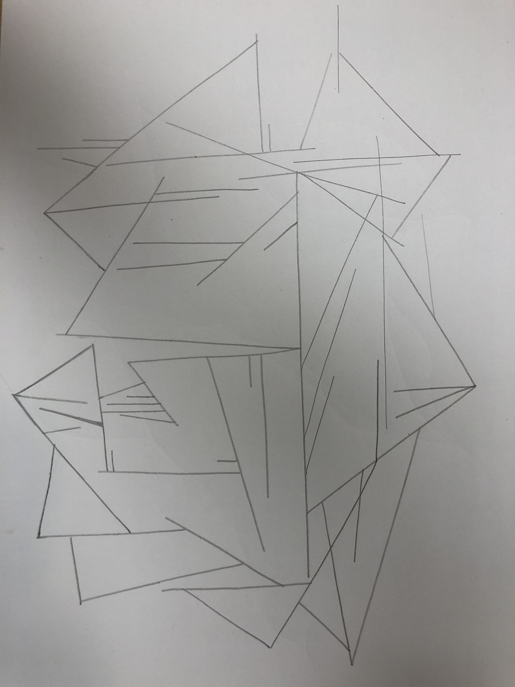
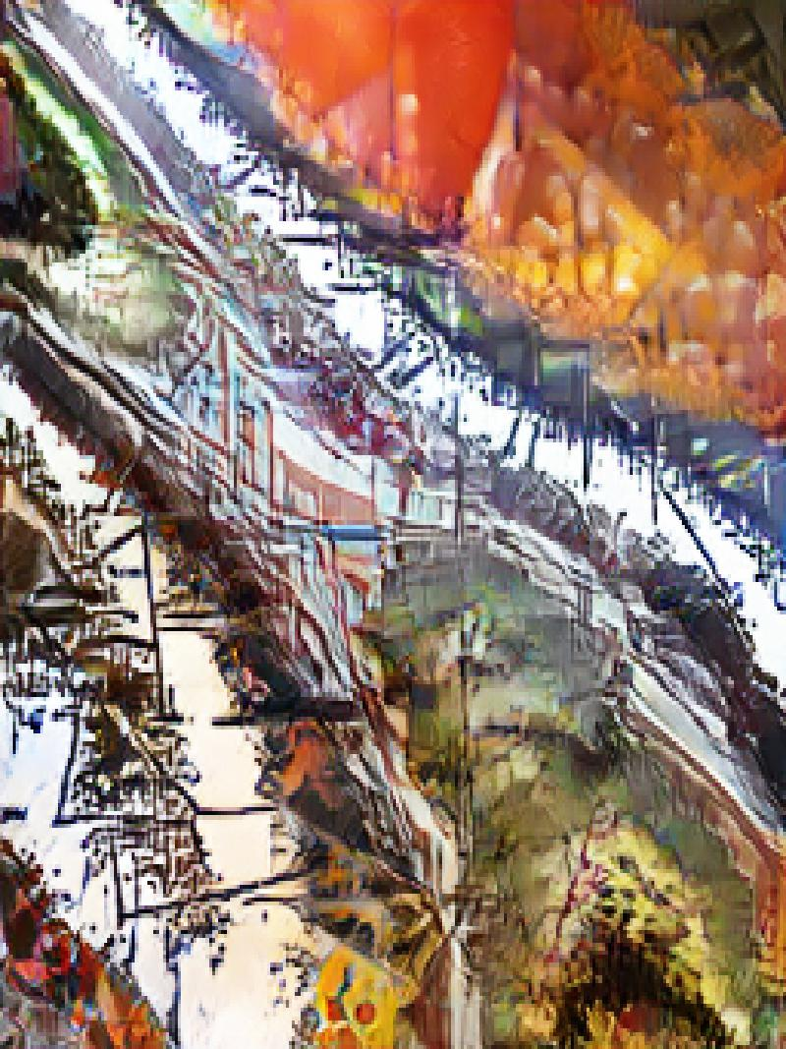
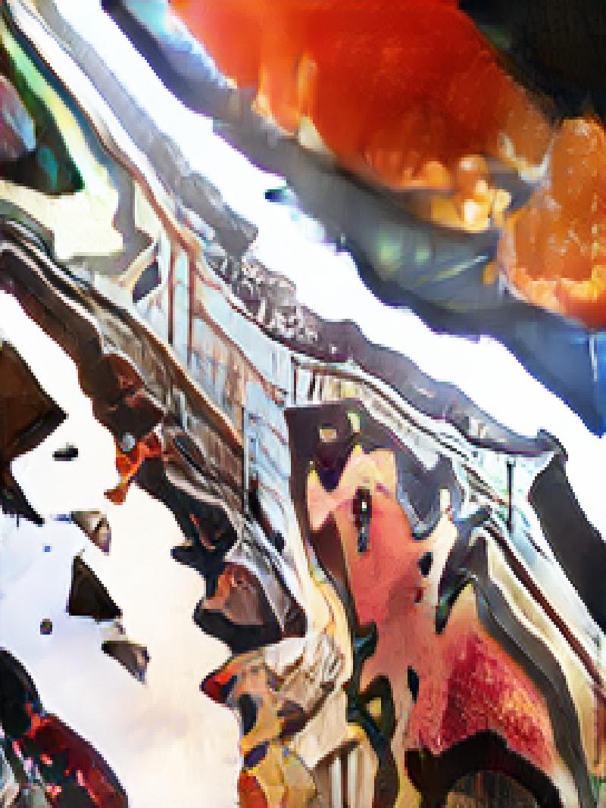
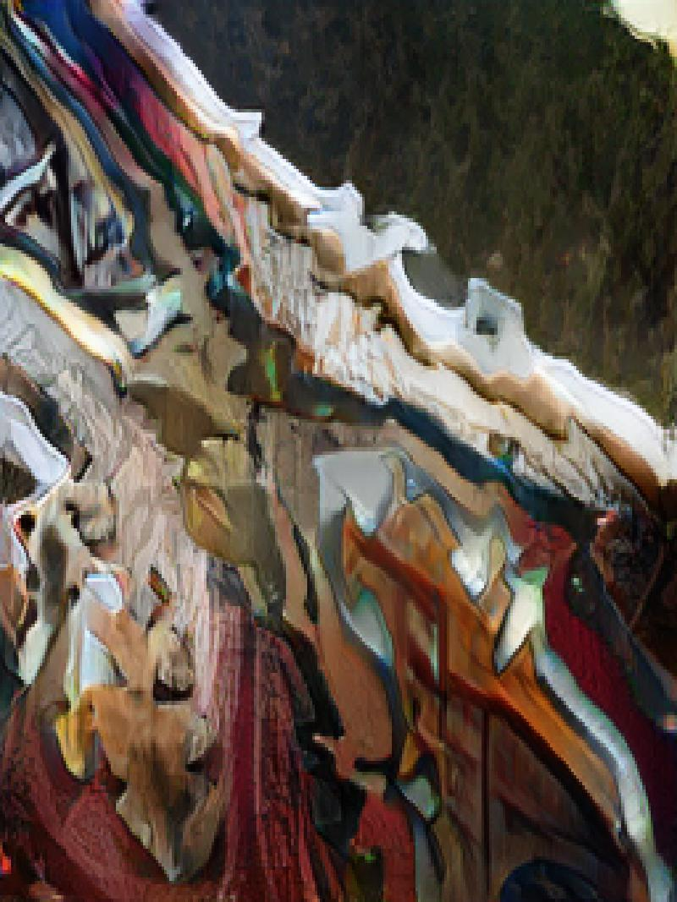

Slide 8
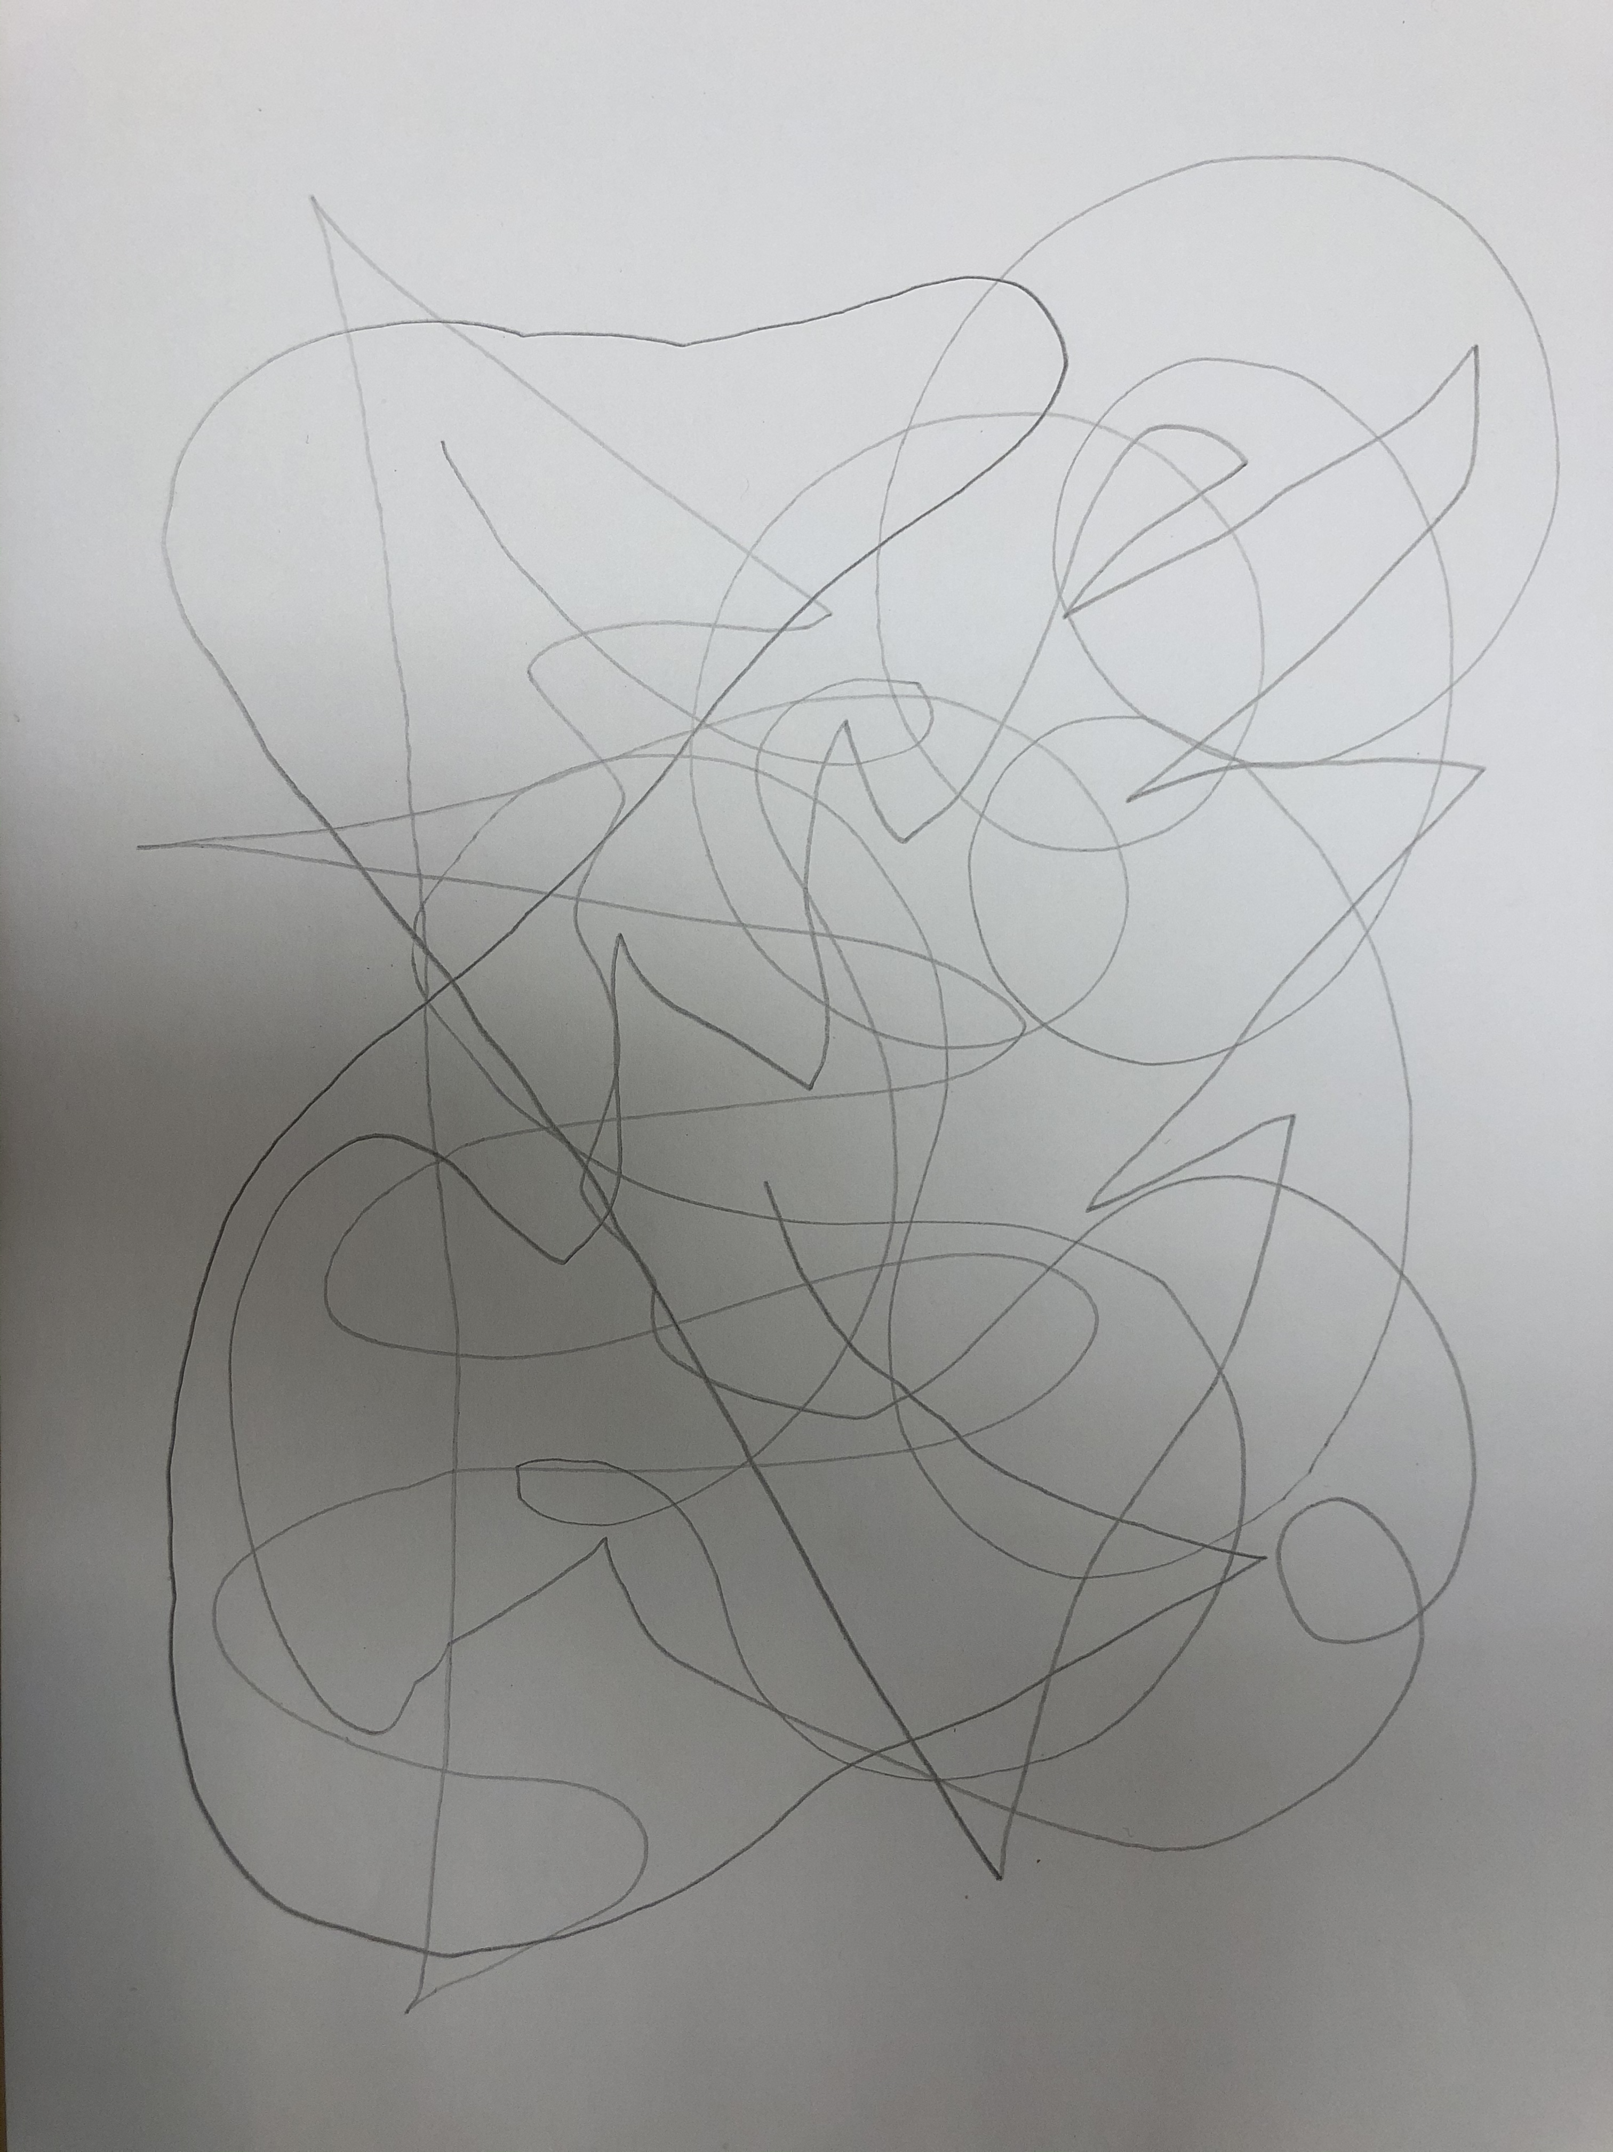
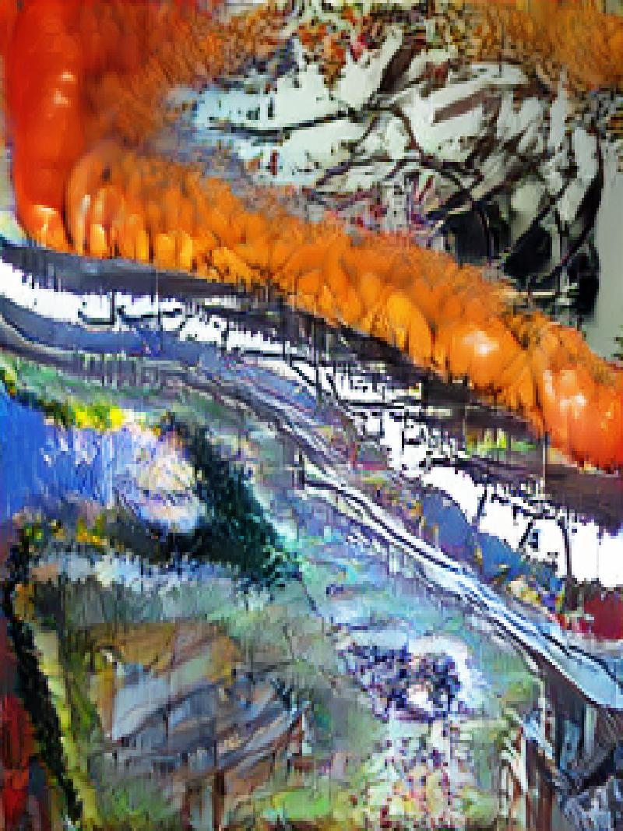
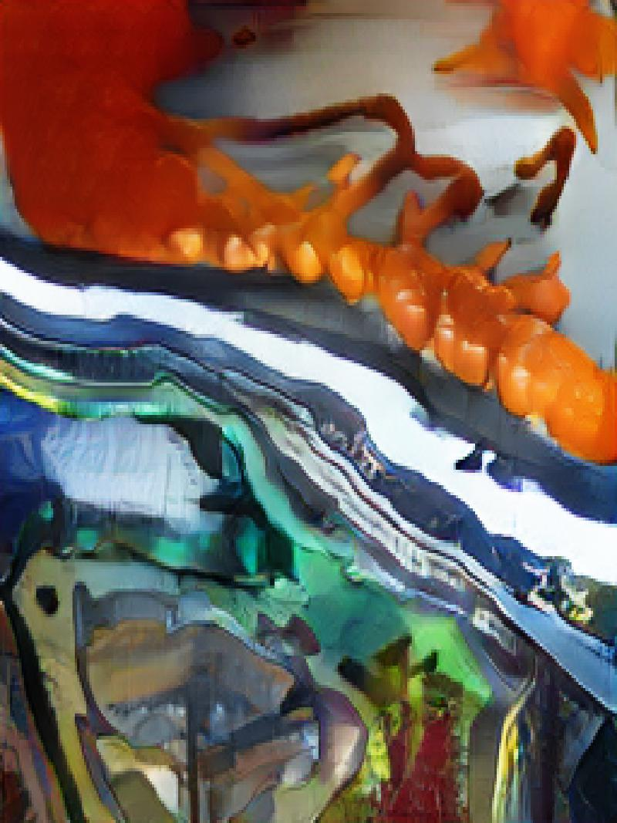
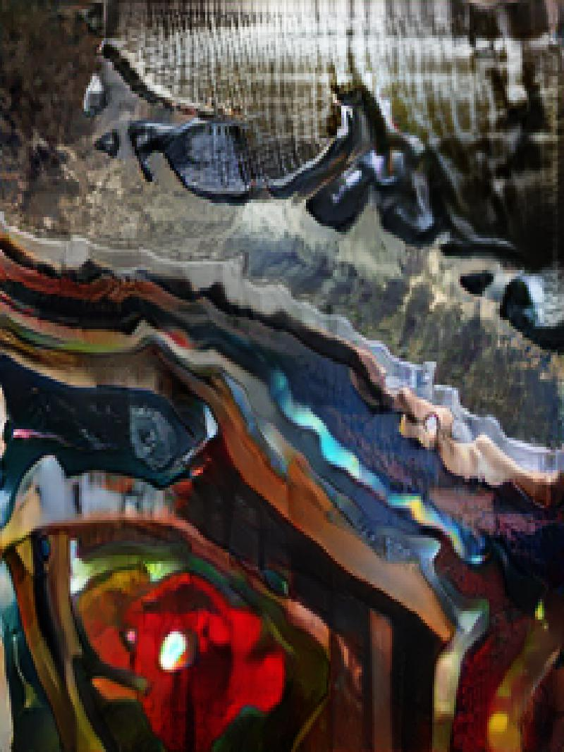

Slide 9
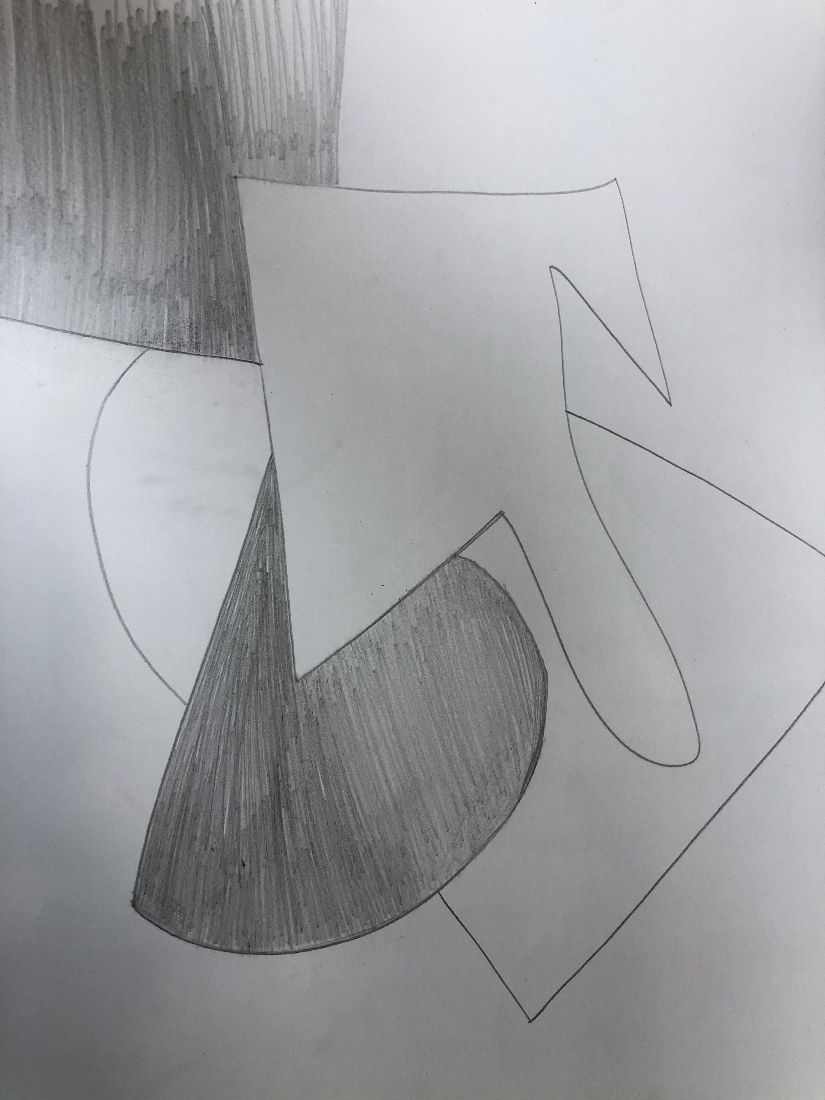
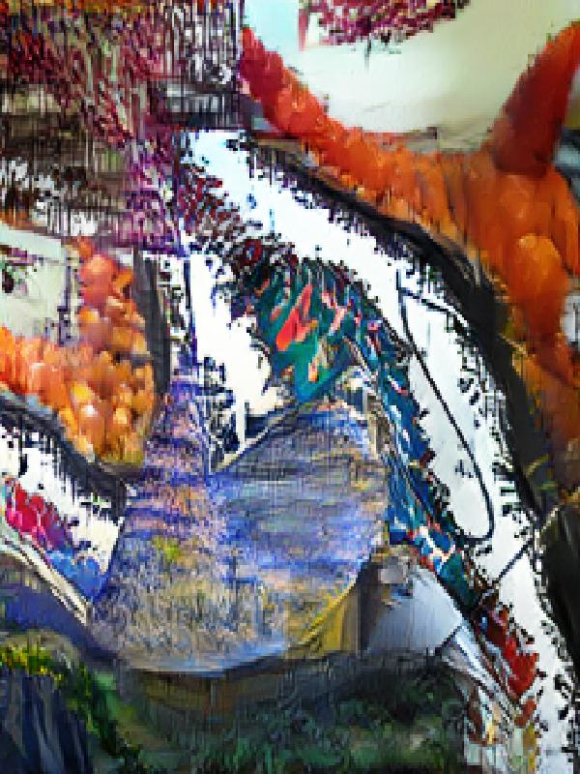
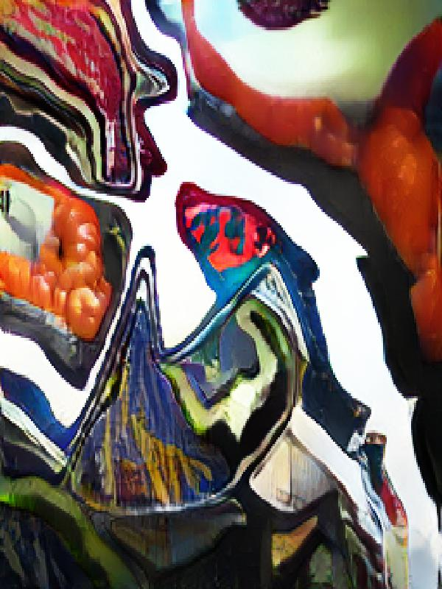
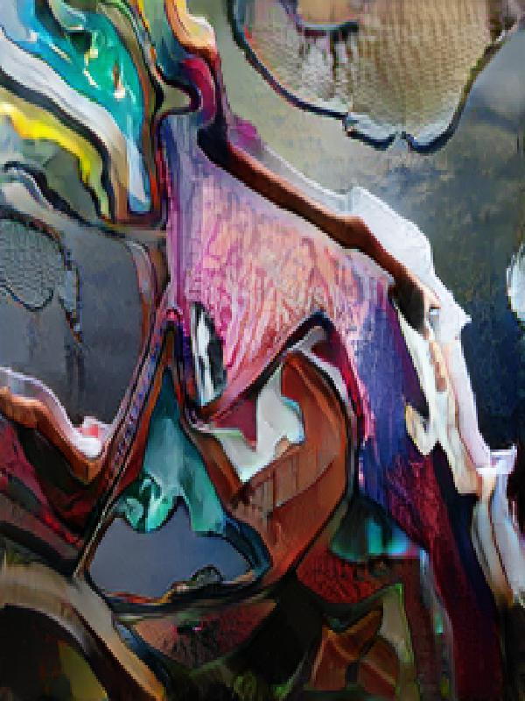

Slide 10
Digitally drawn inputs

Slide 11
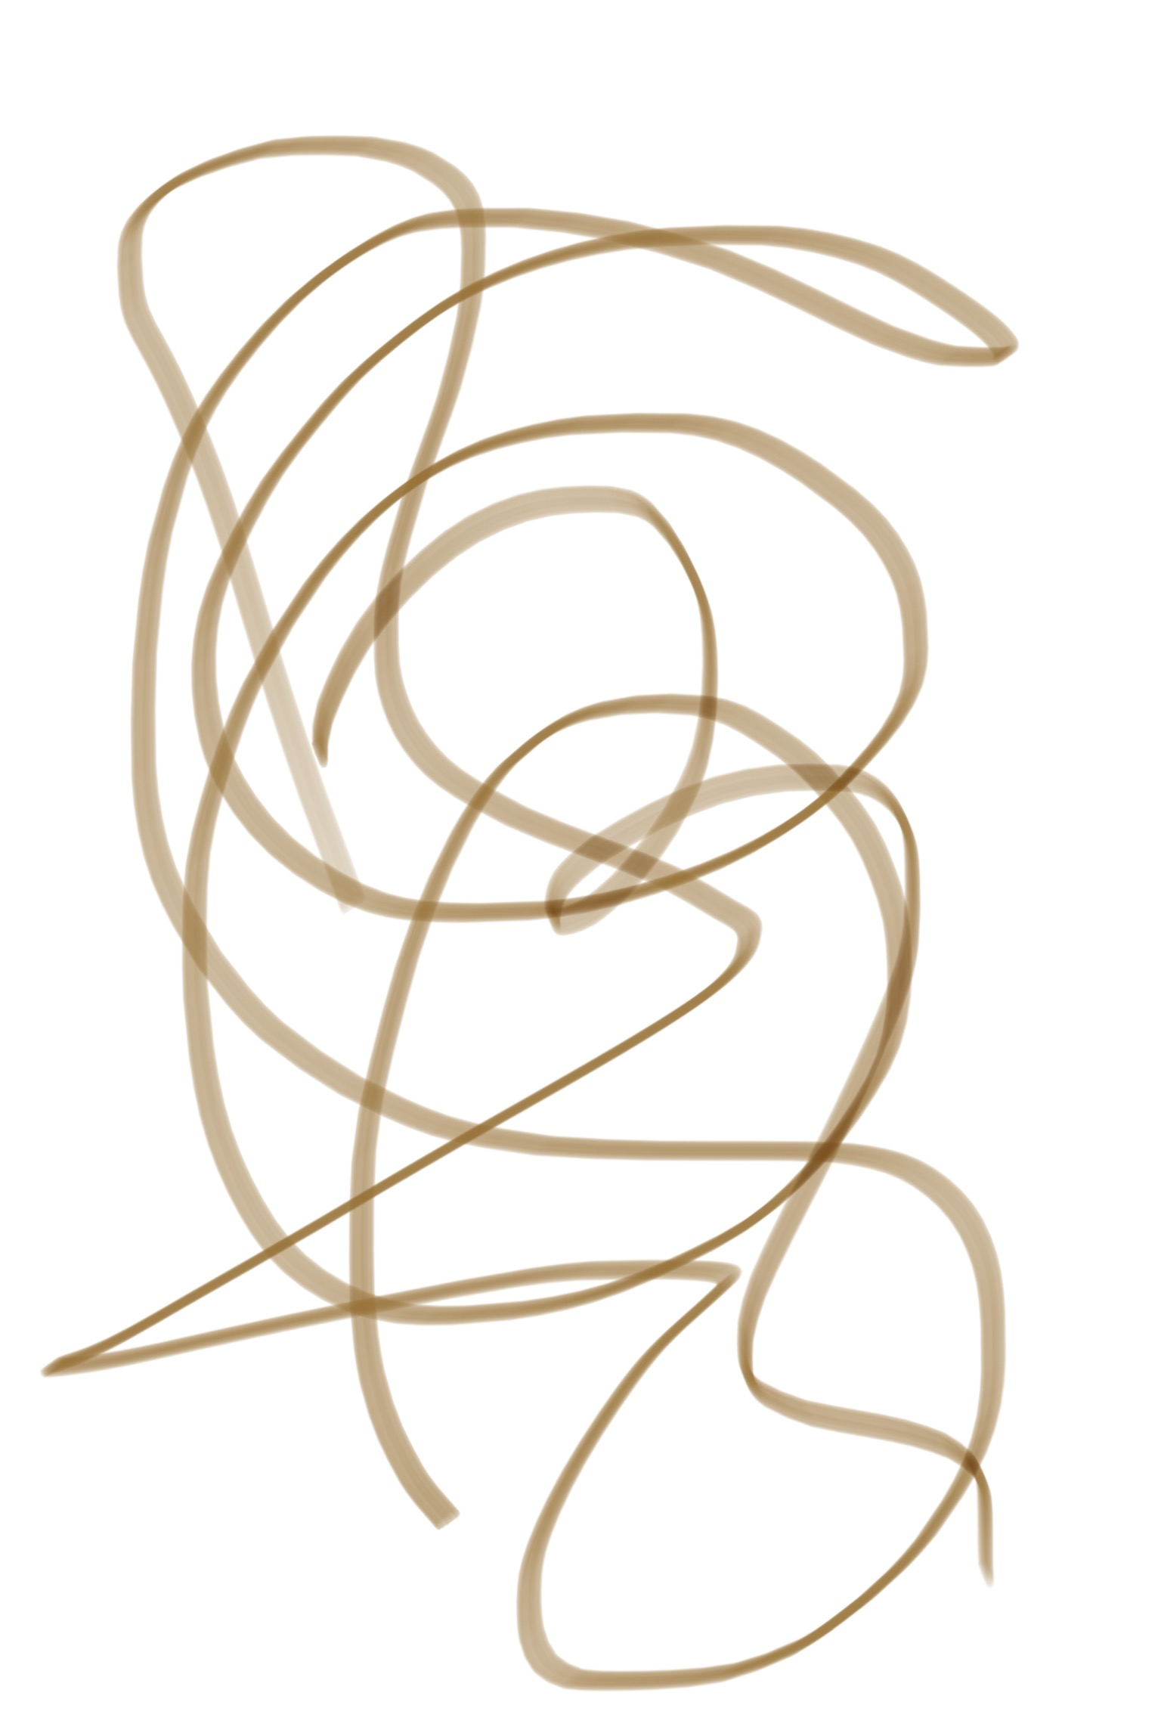
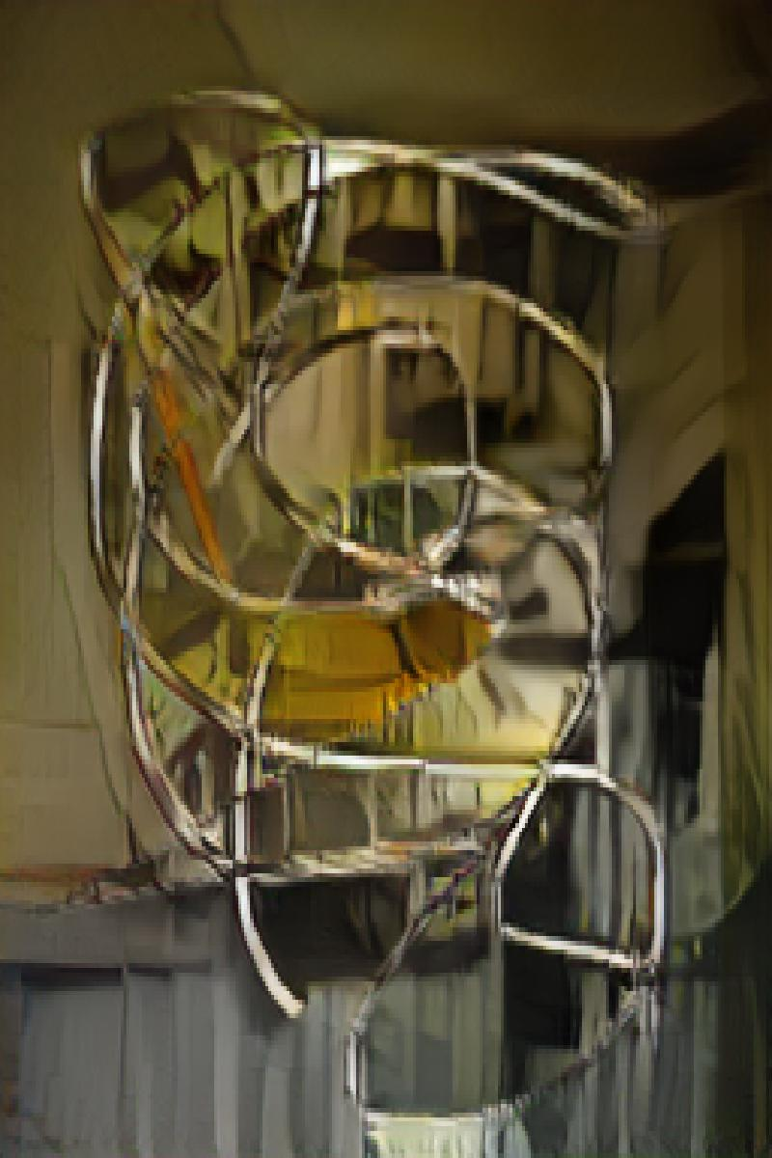
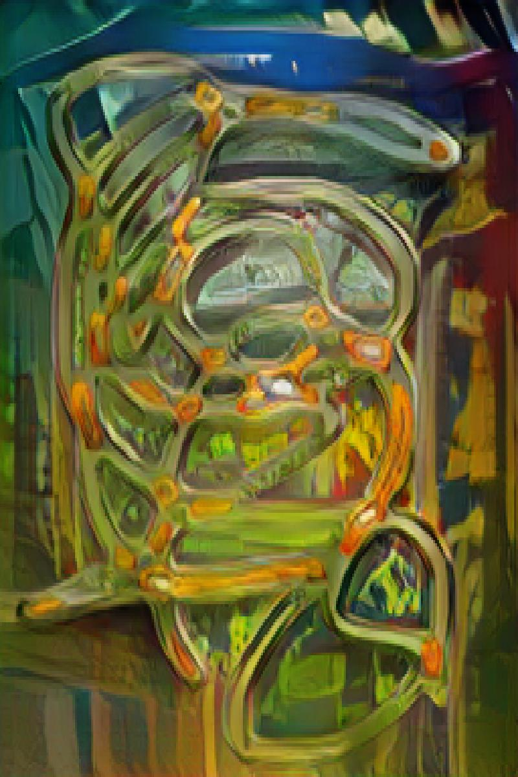
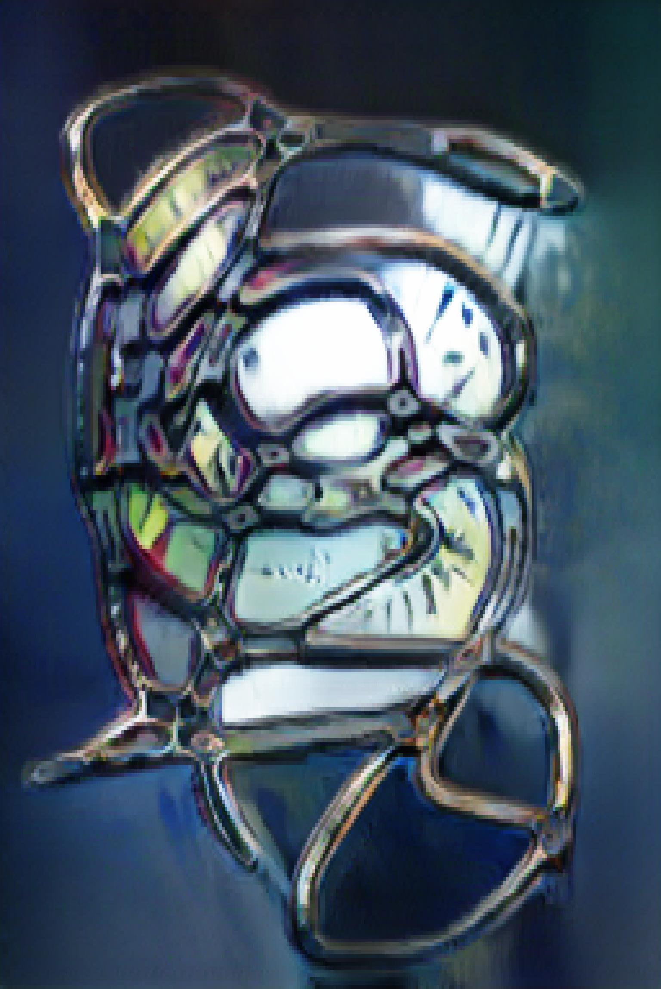

Slide 12
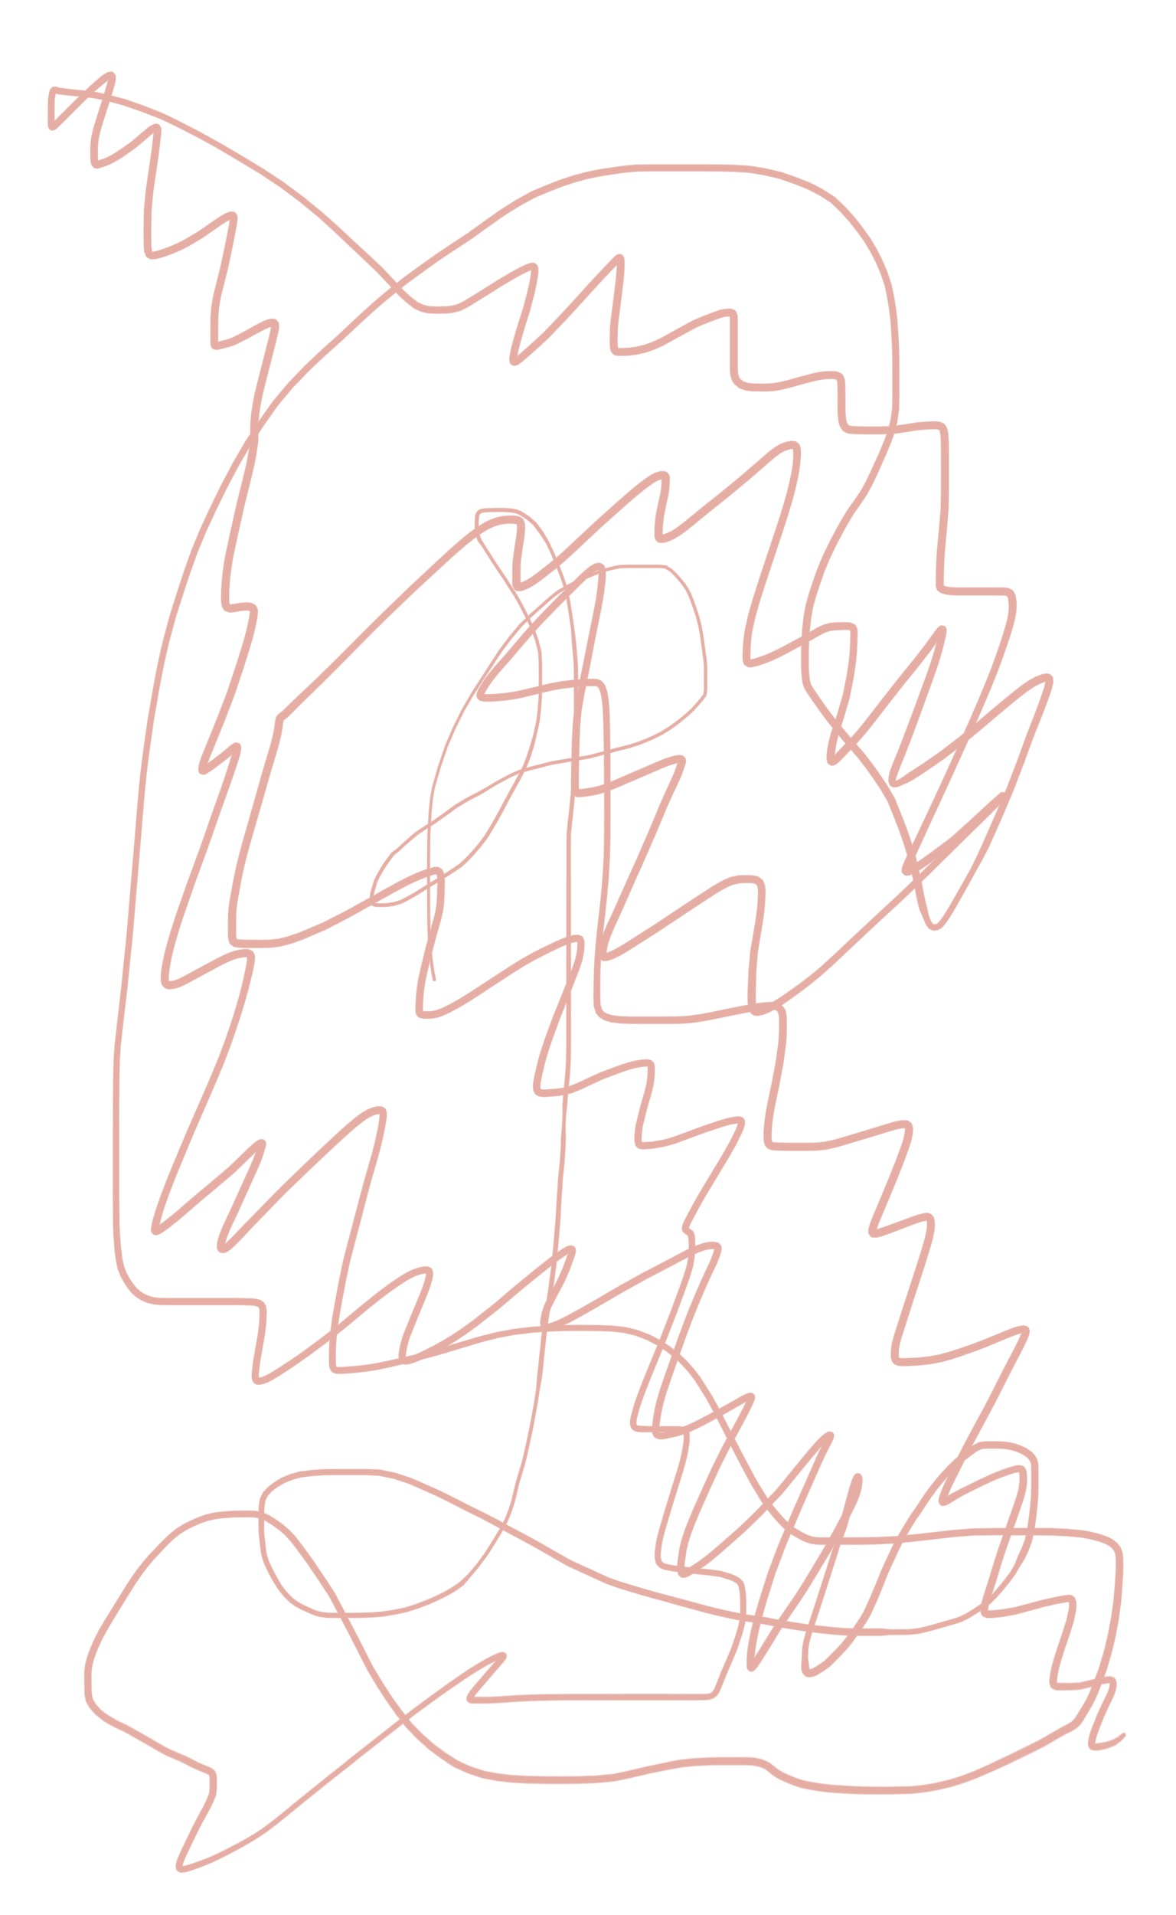
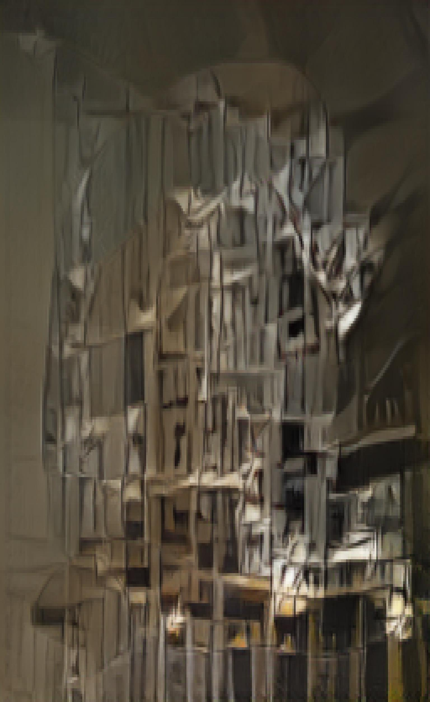
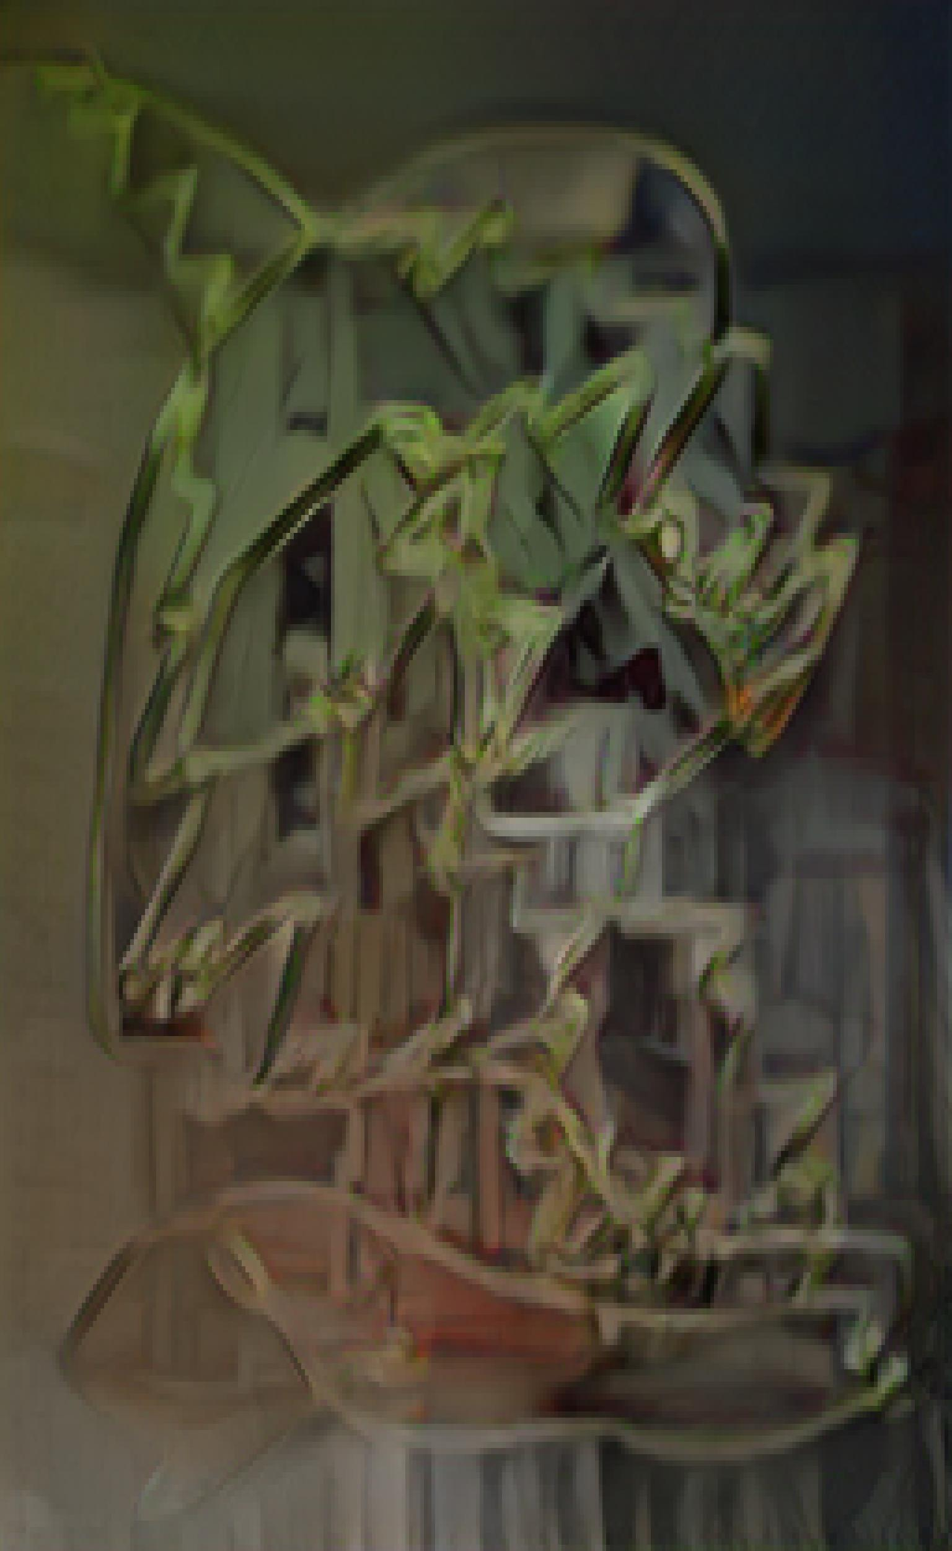
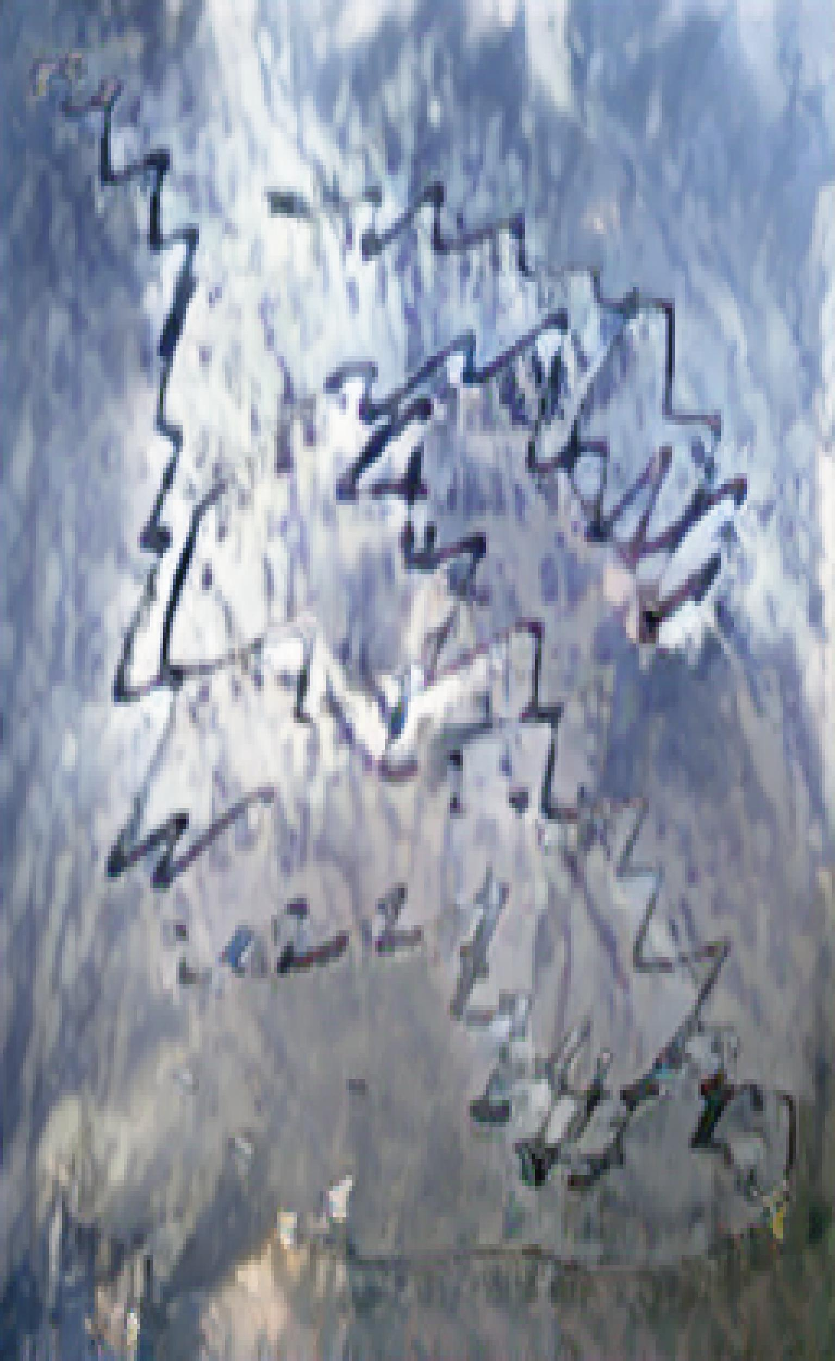

Slide 13
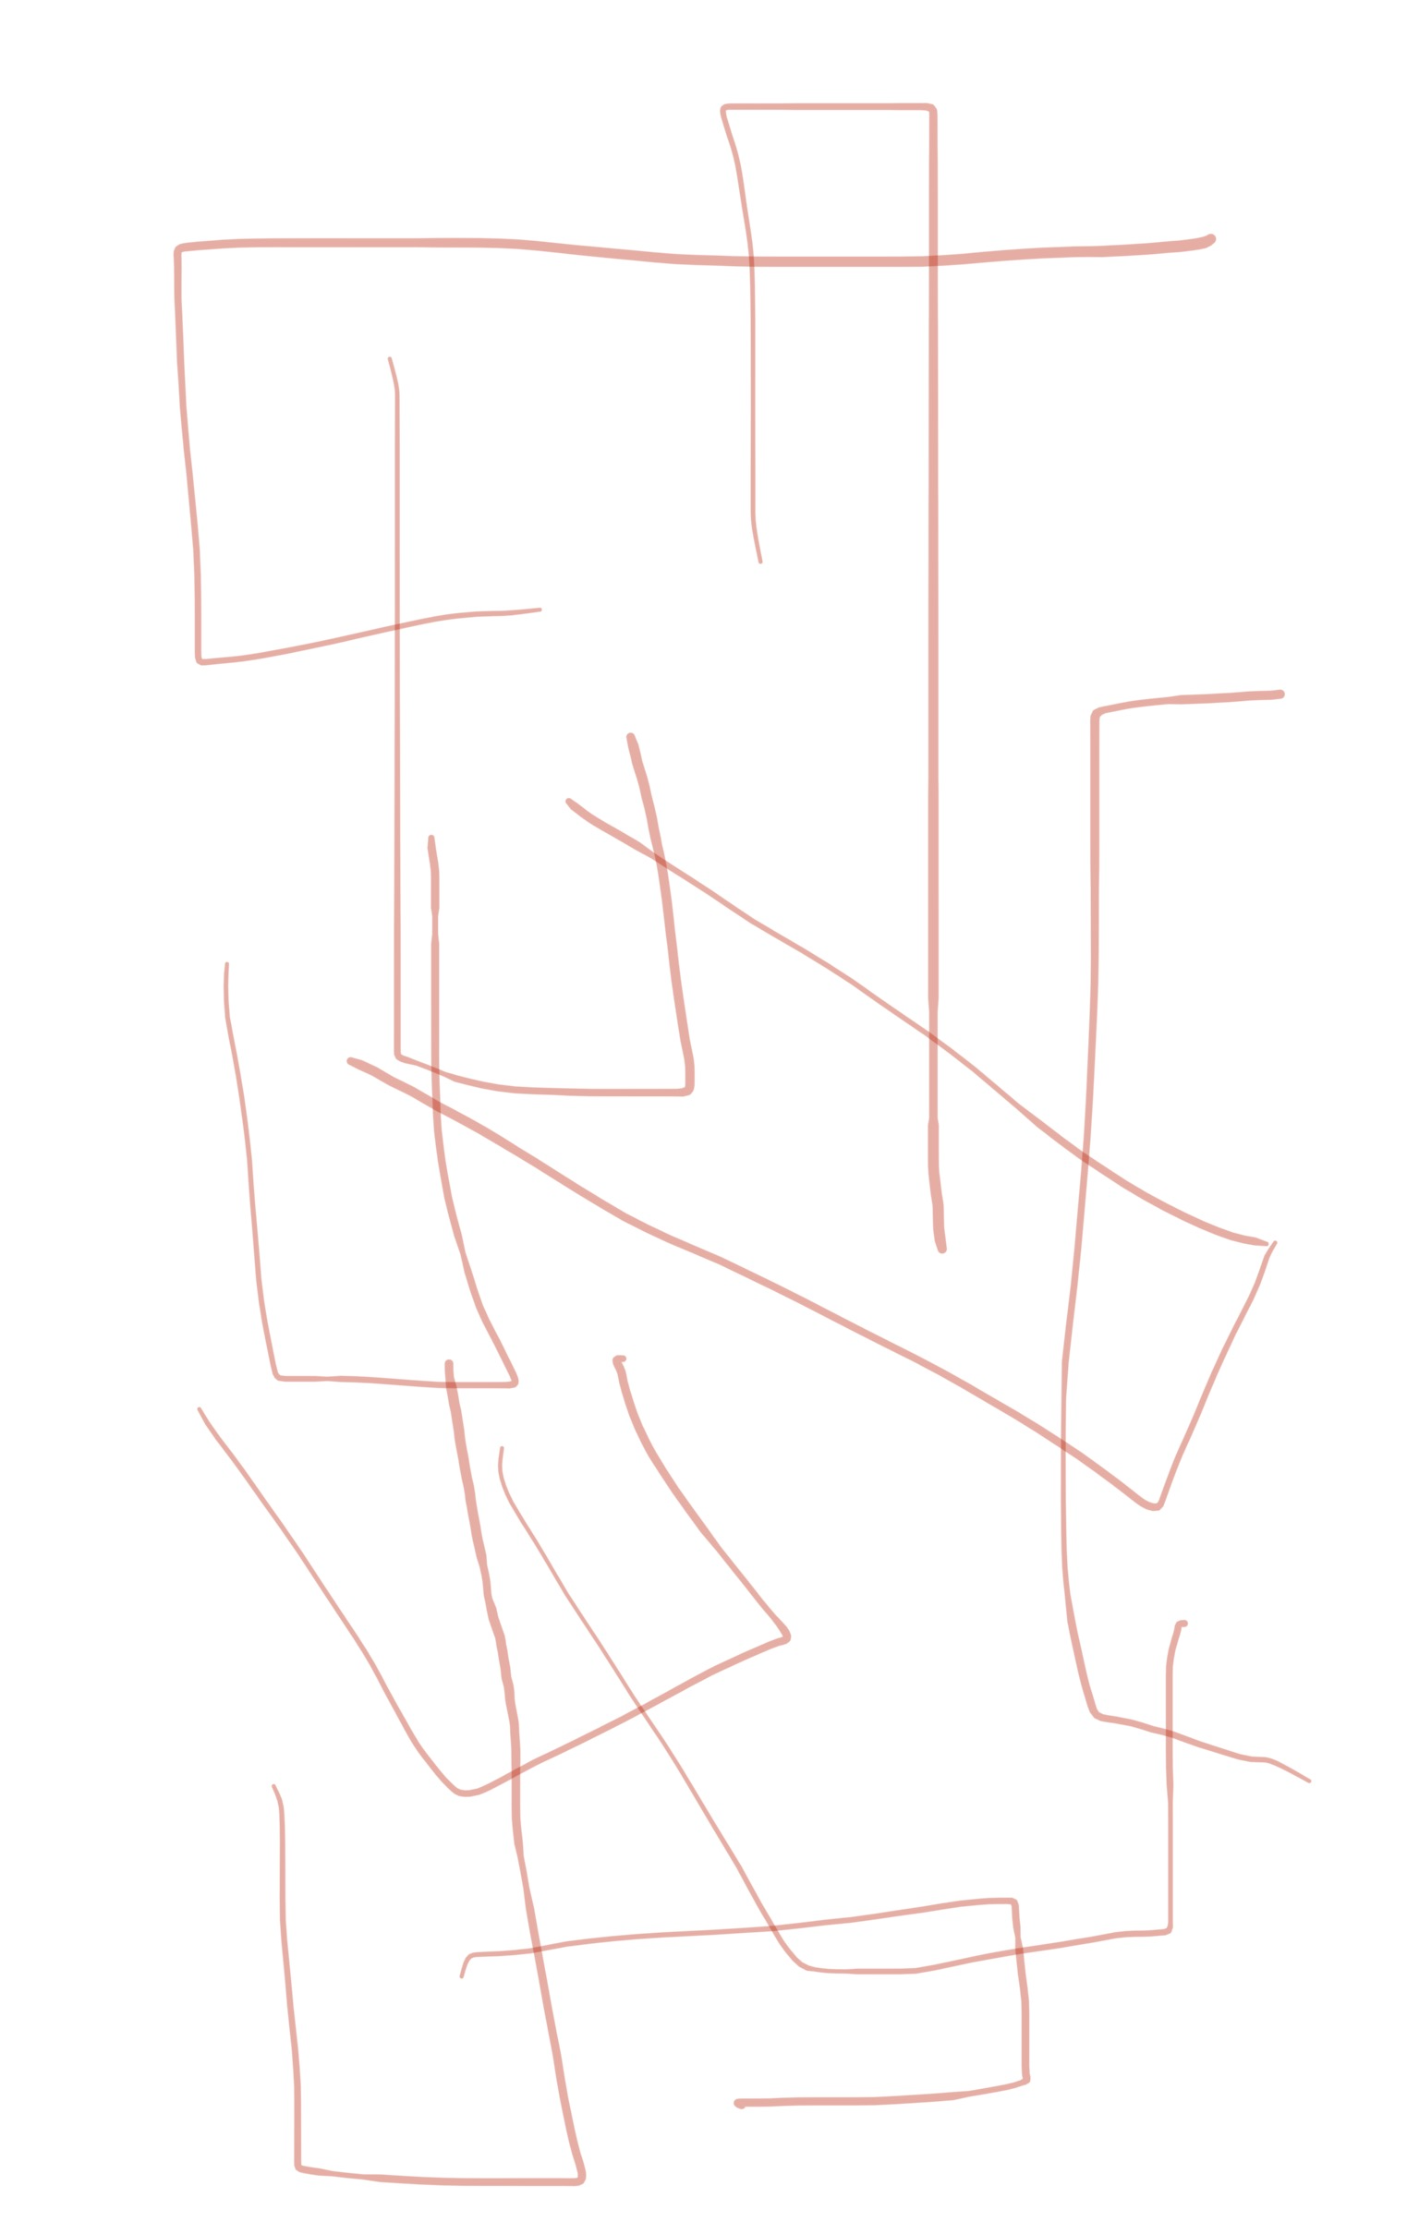
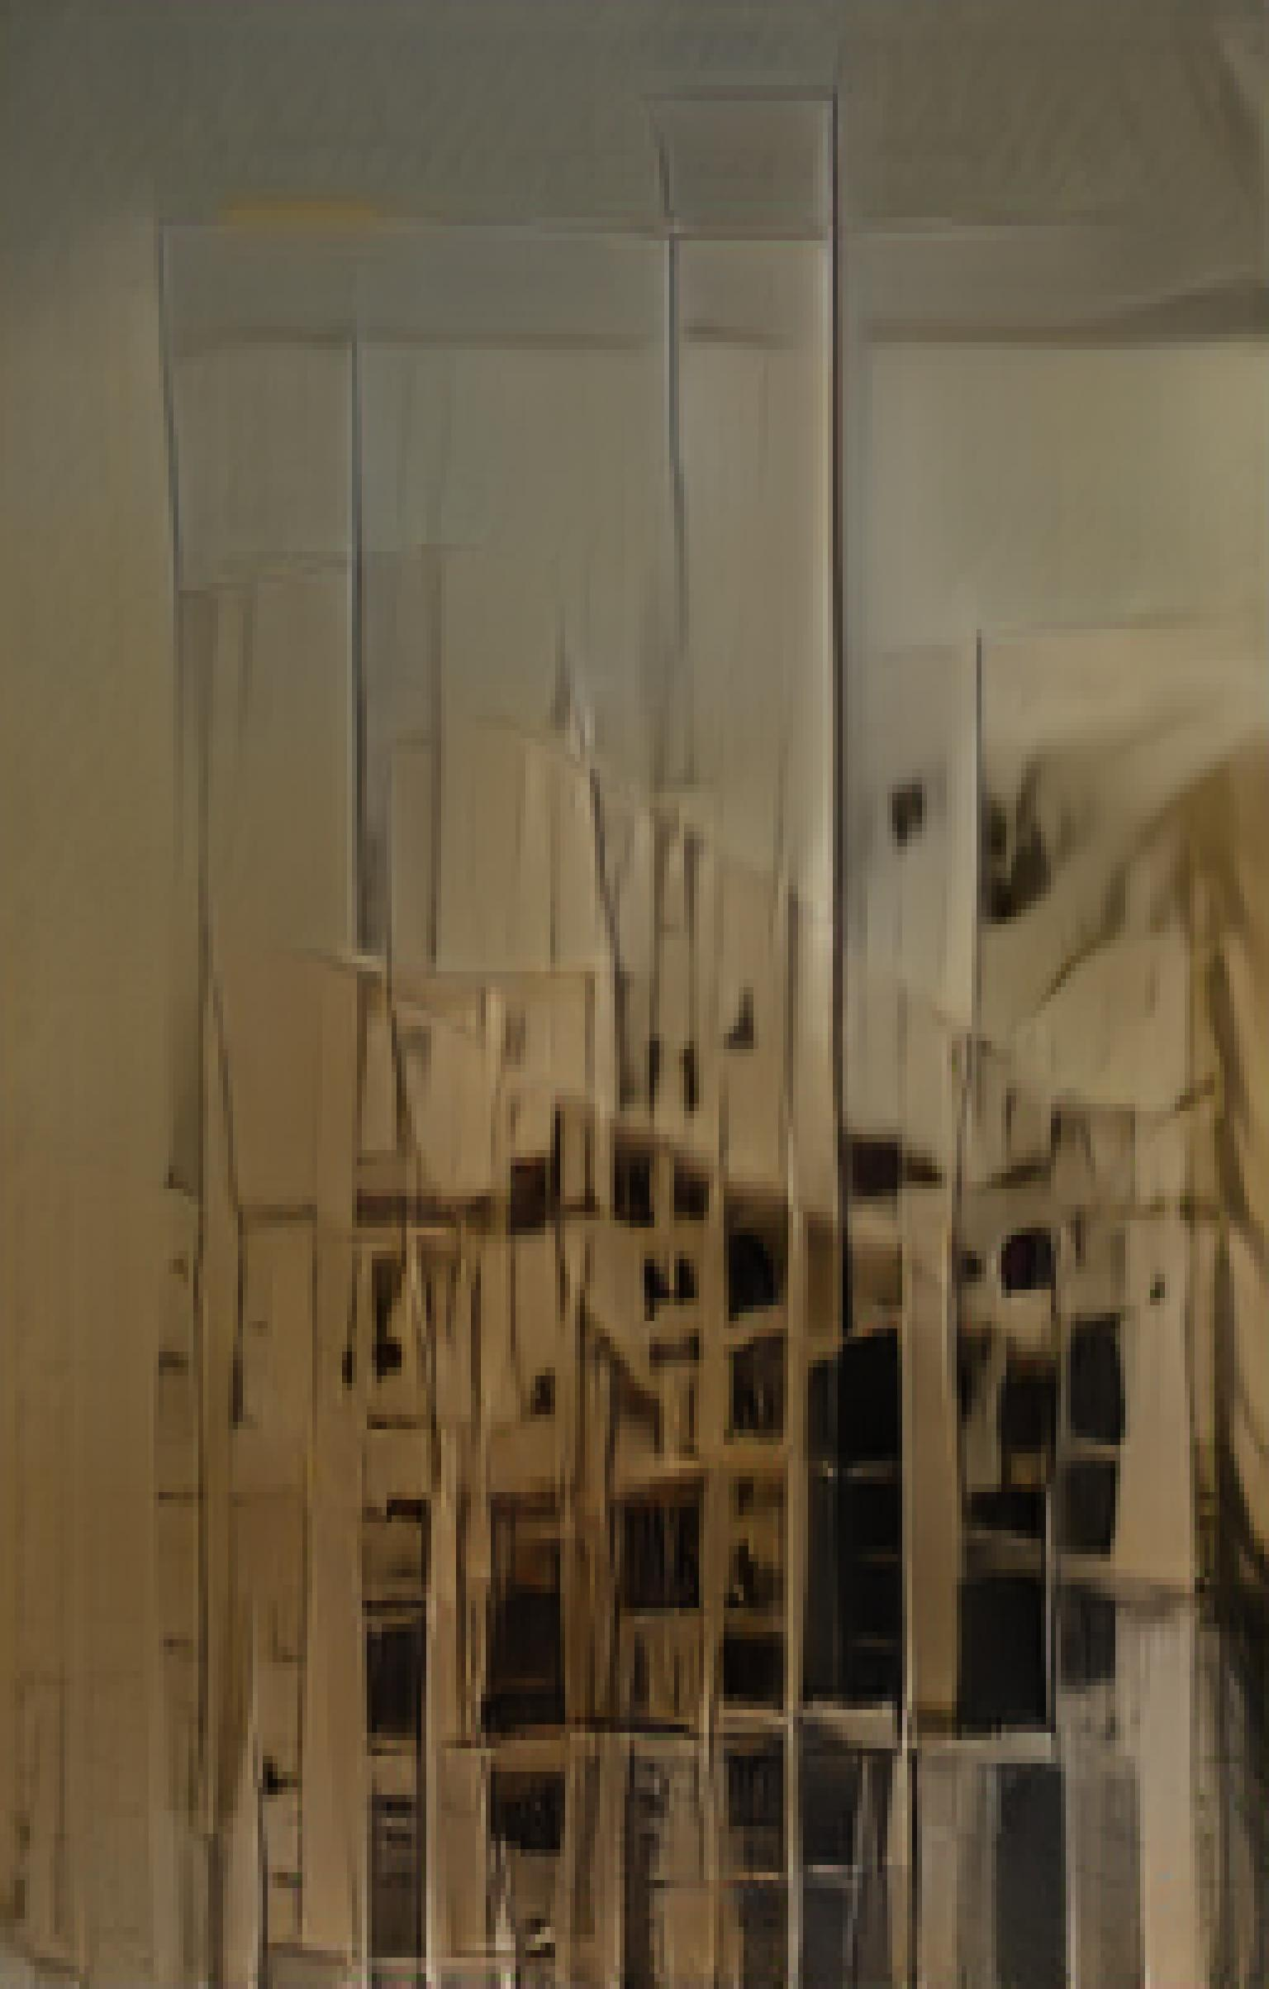
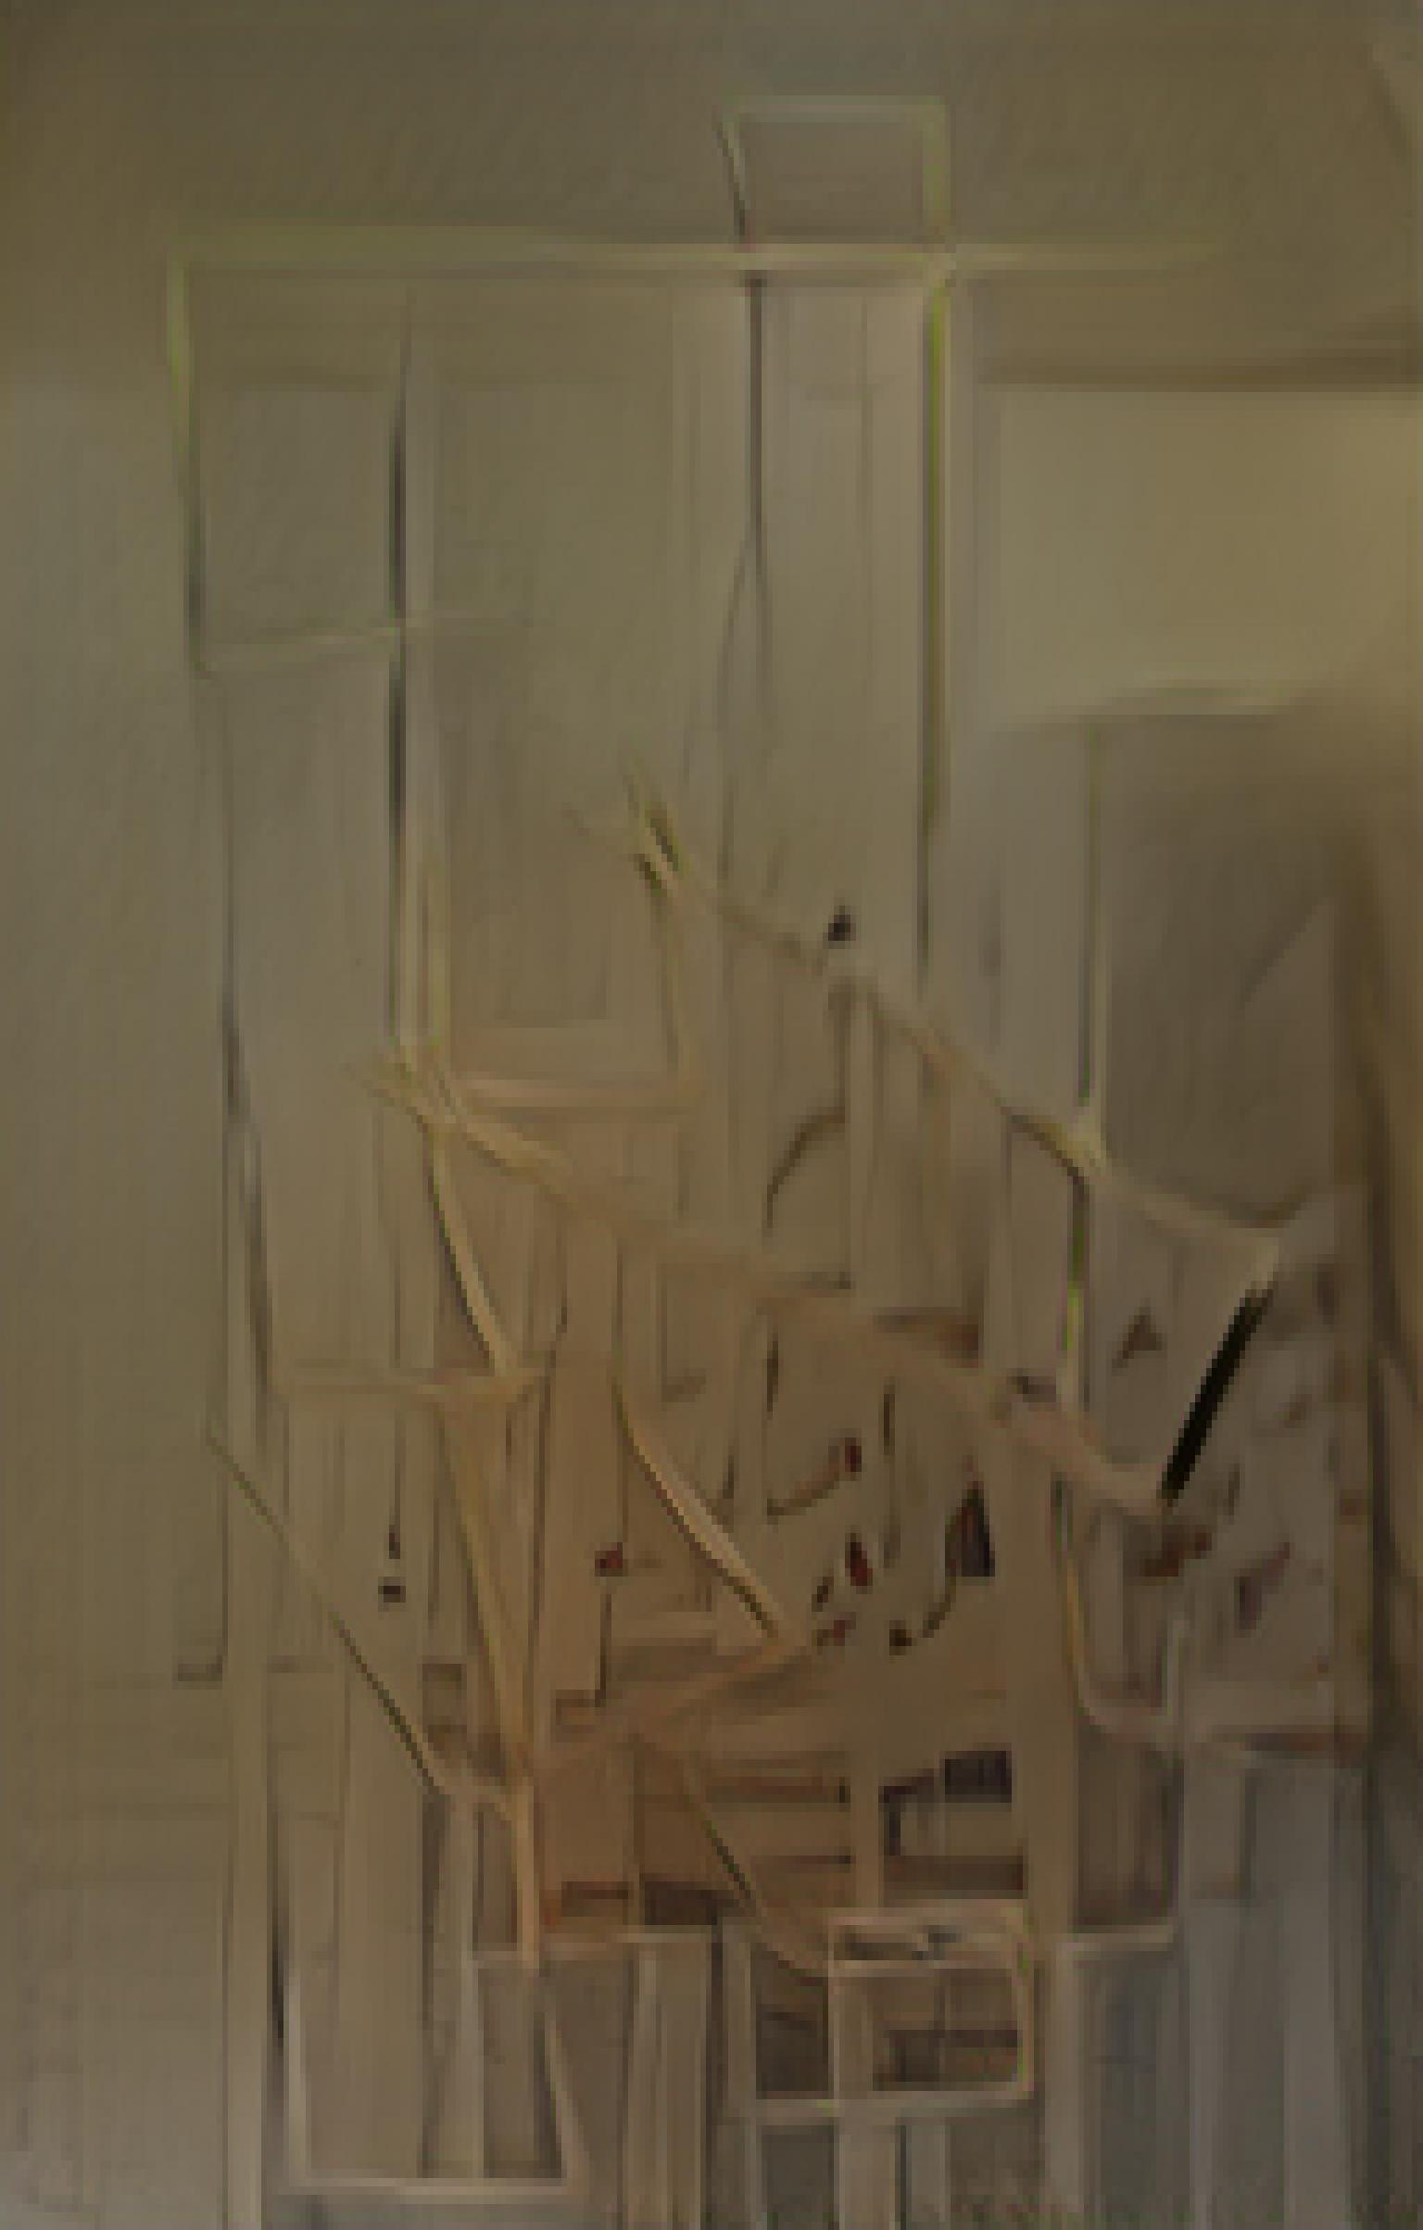
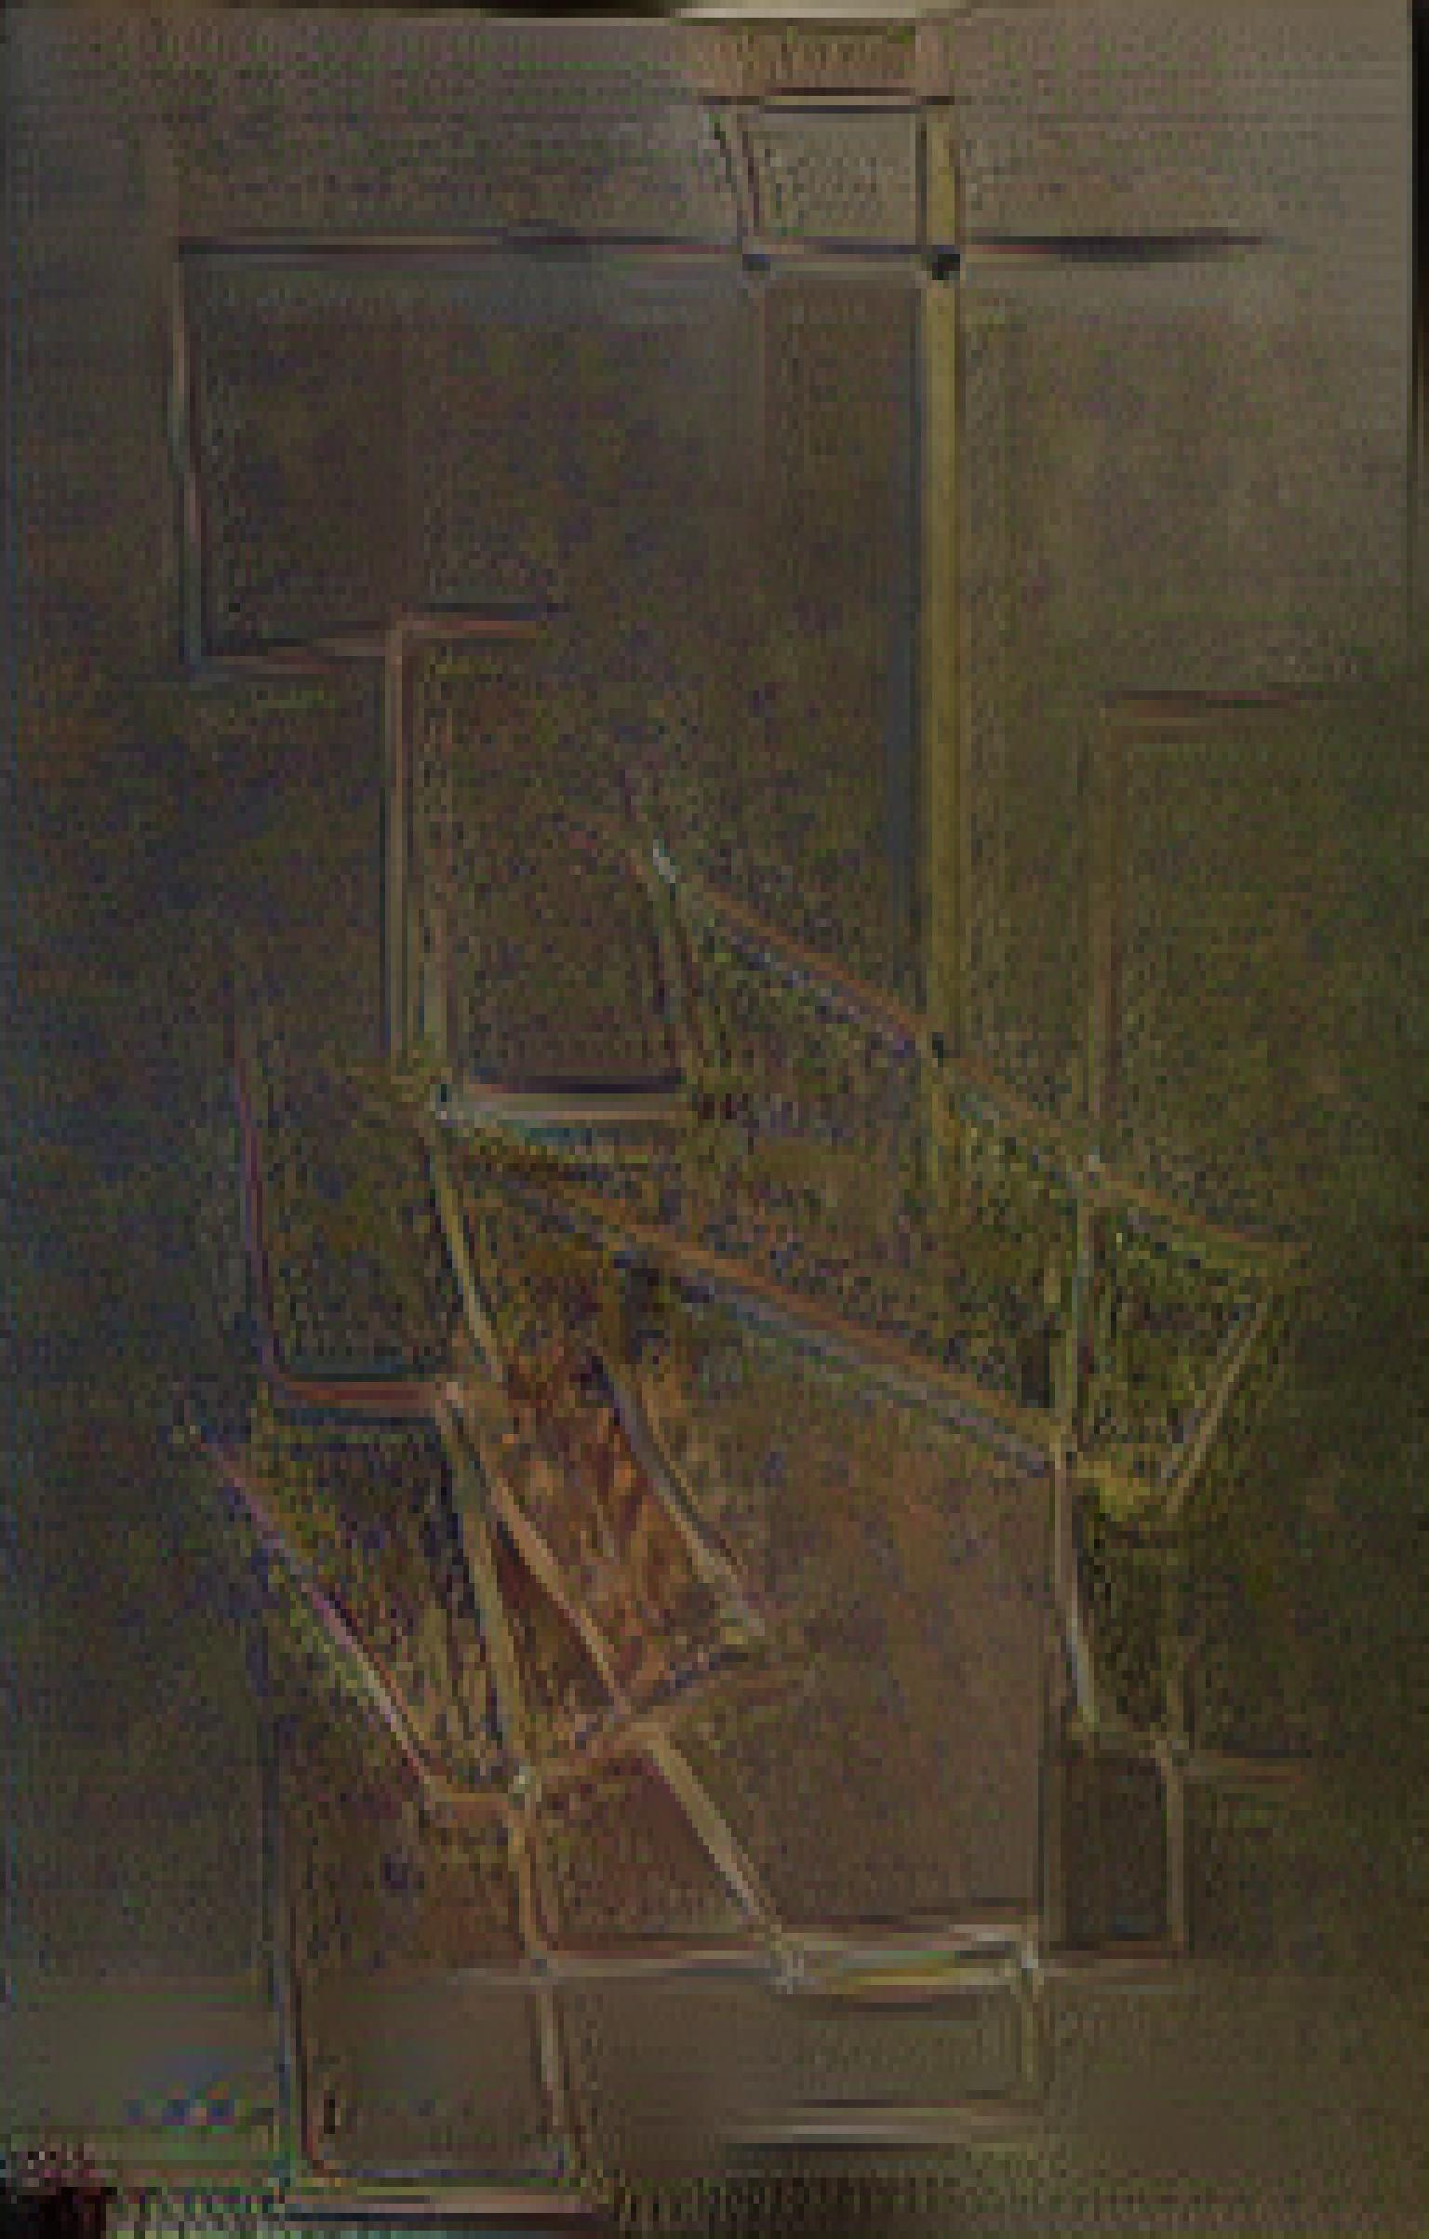

Slide 14
Plotter inputs

Slide 15
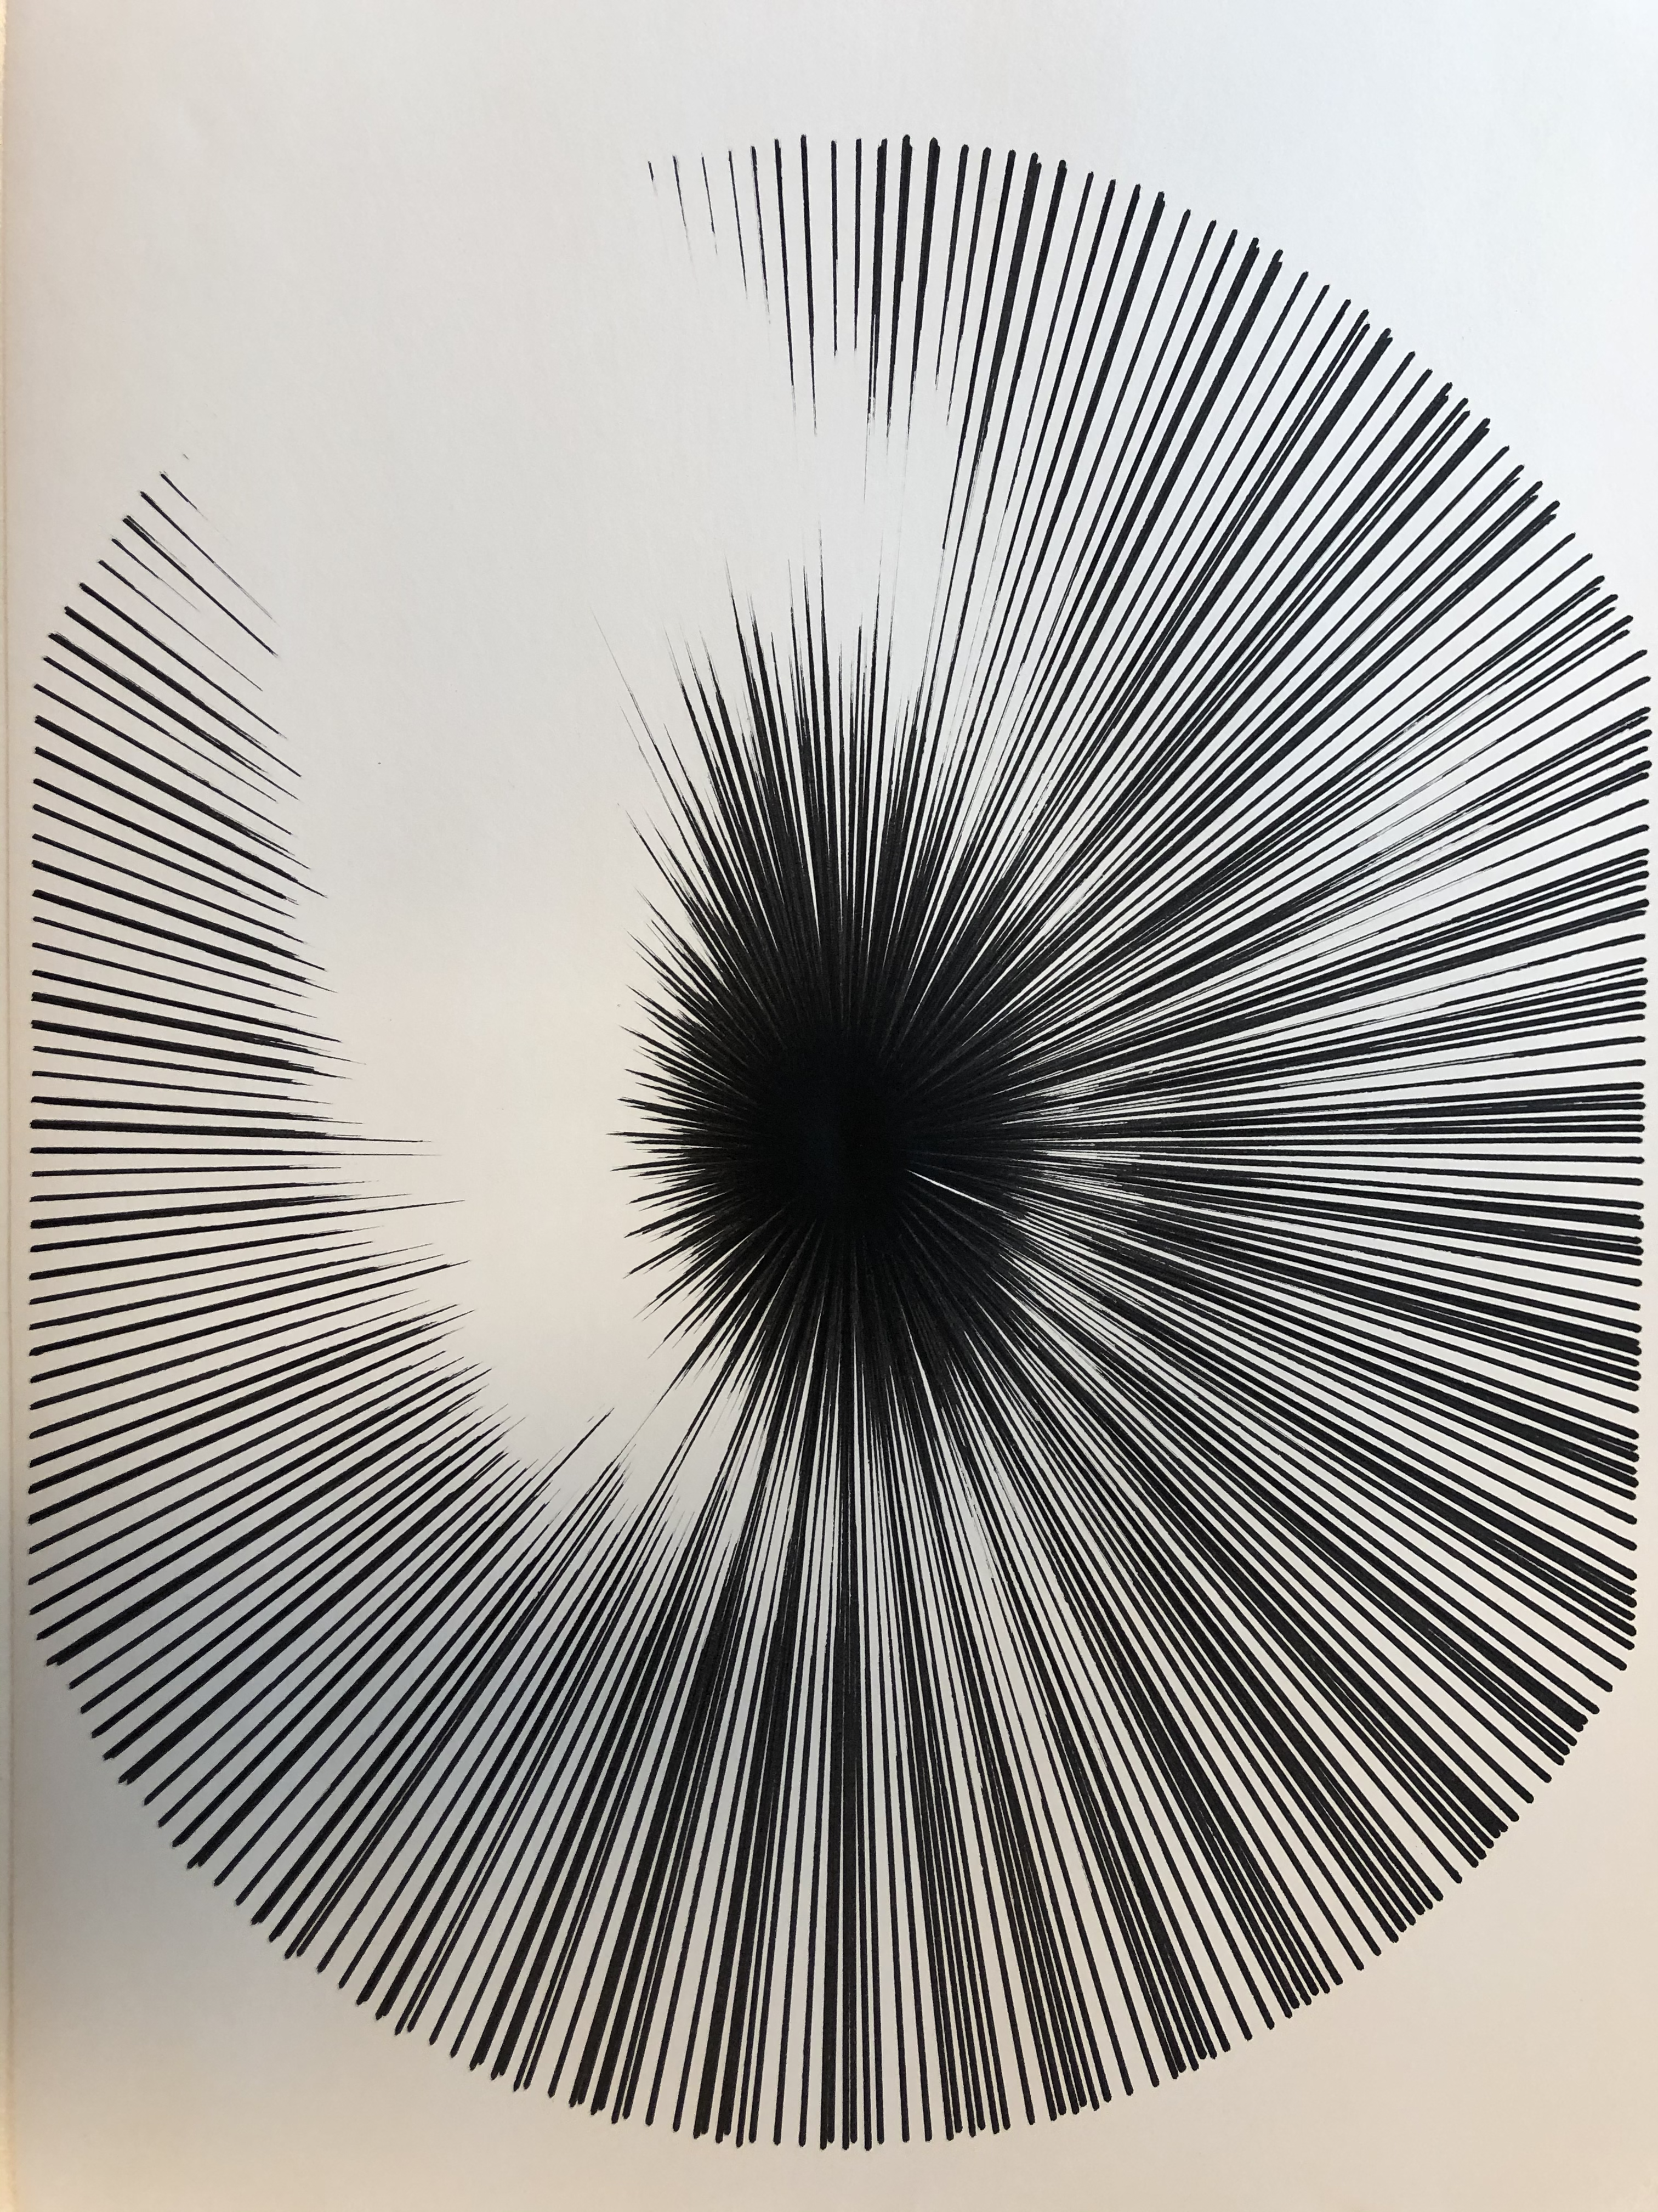
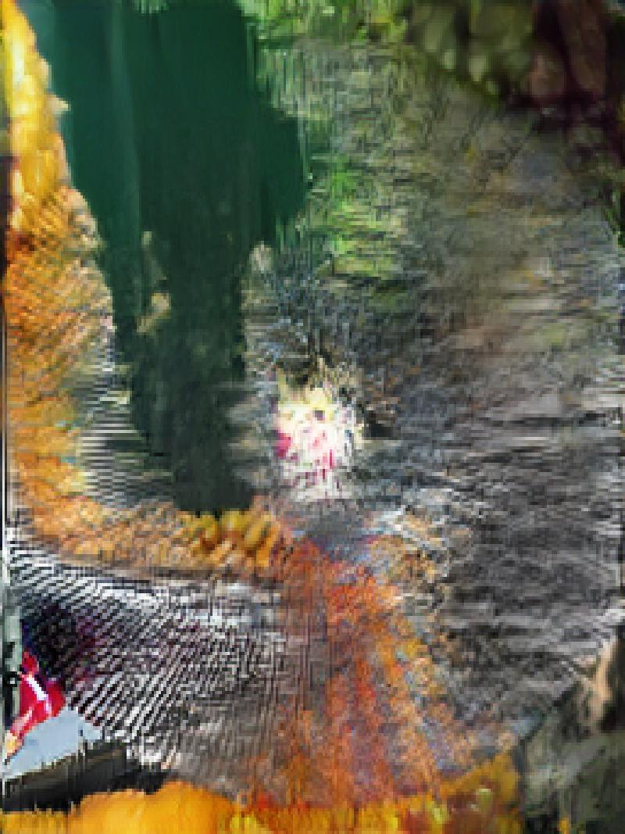
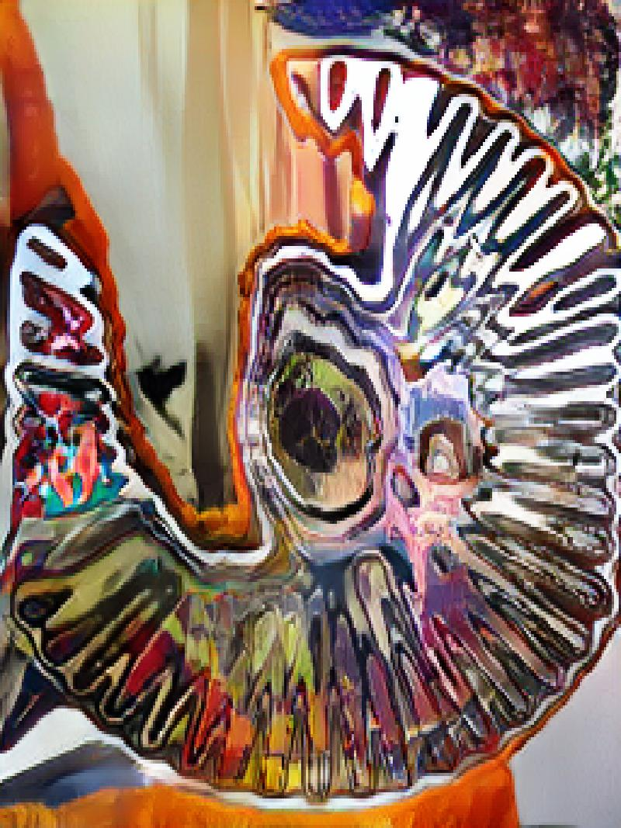
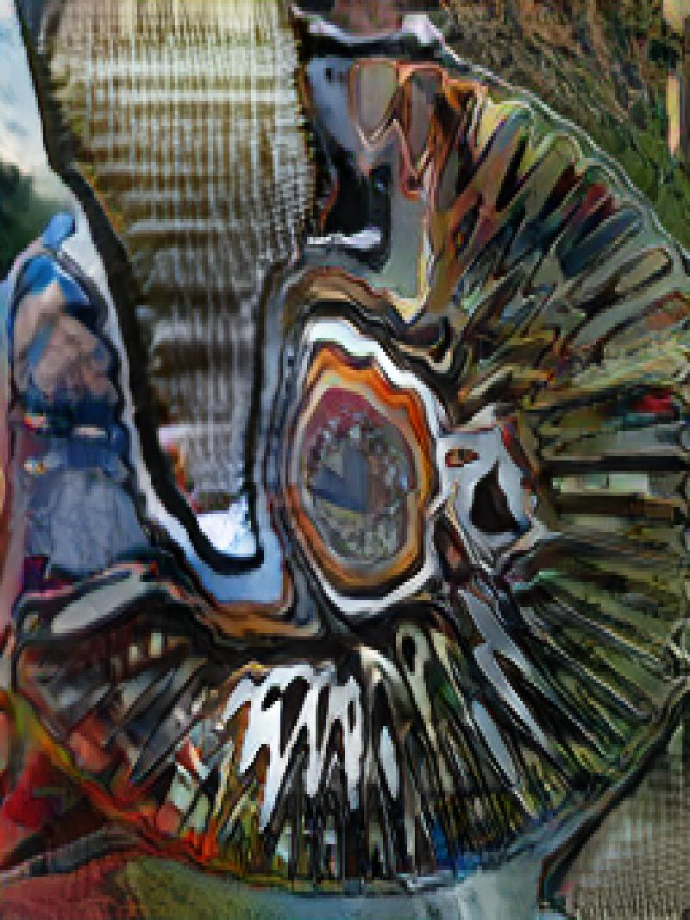

Slide 16
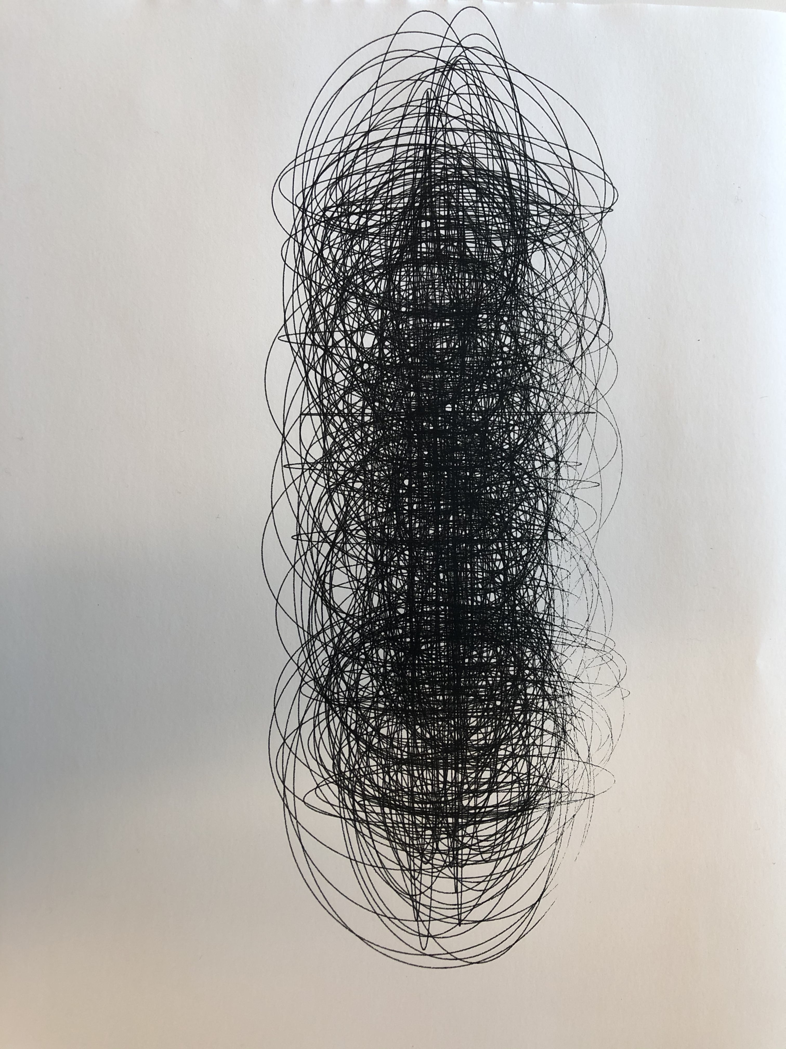
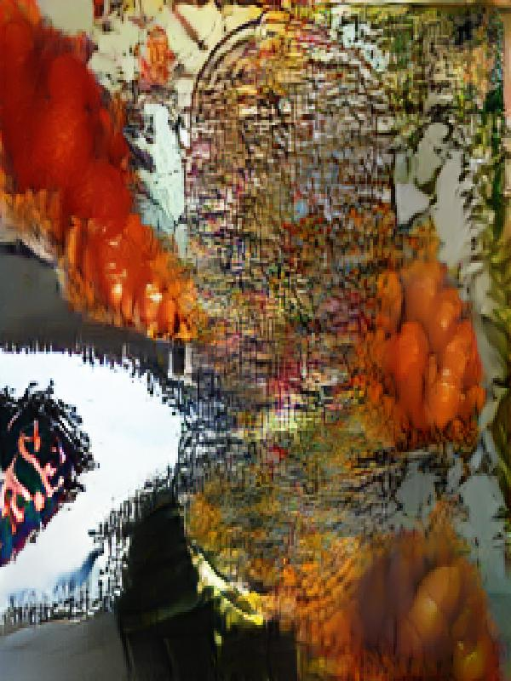
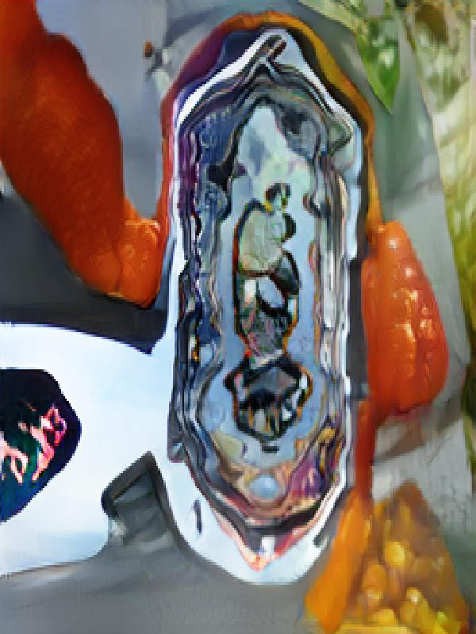
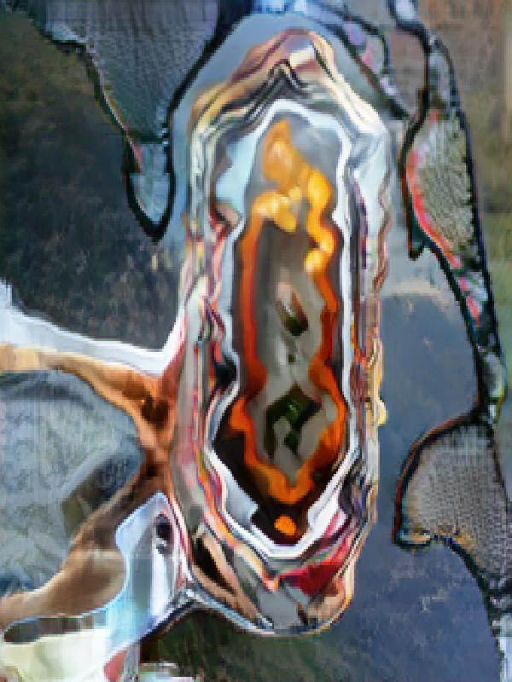

Slide 18
Digitally coded inputs

Slide 19
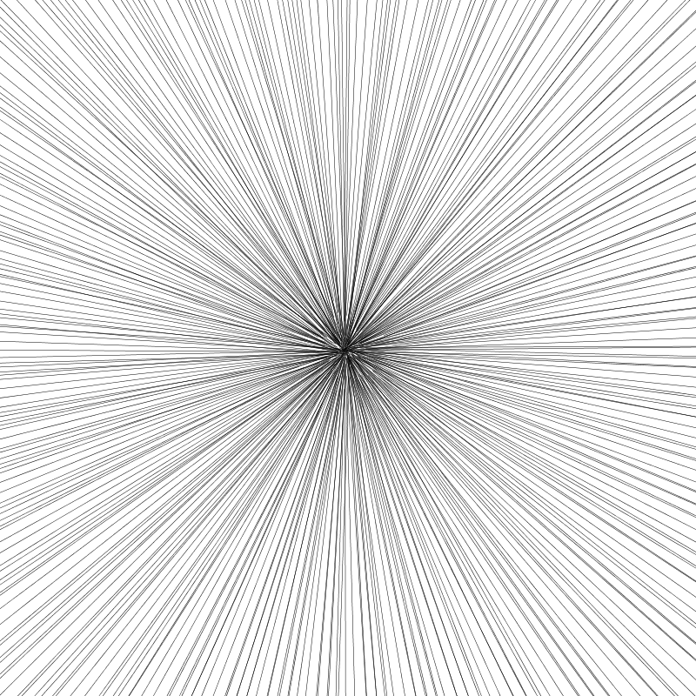
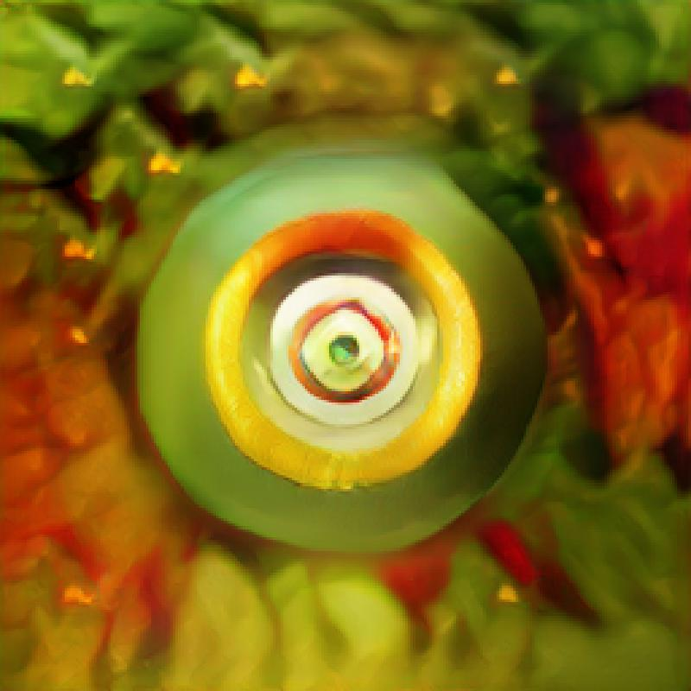
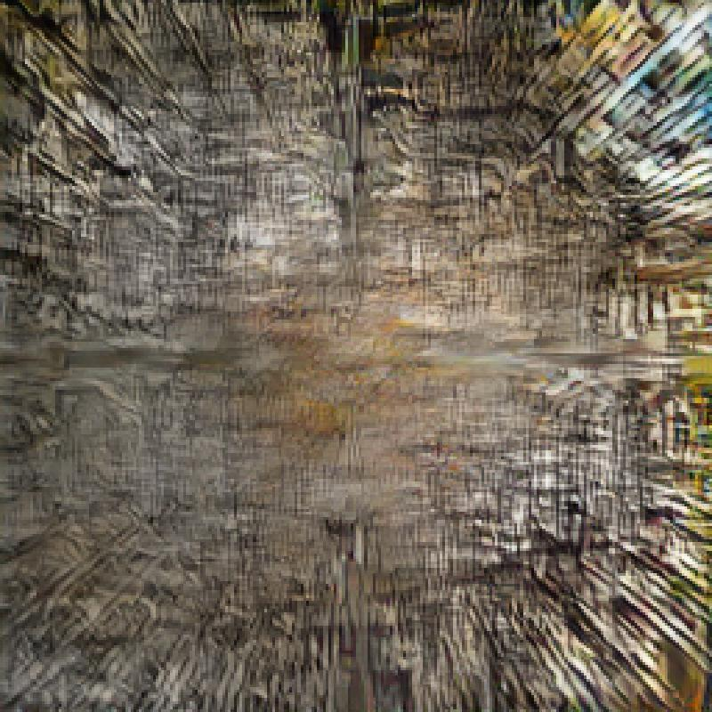
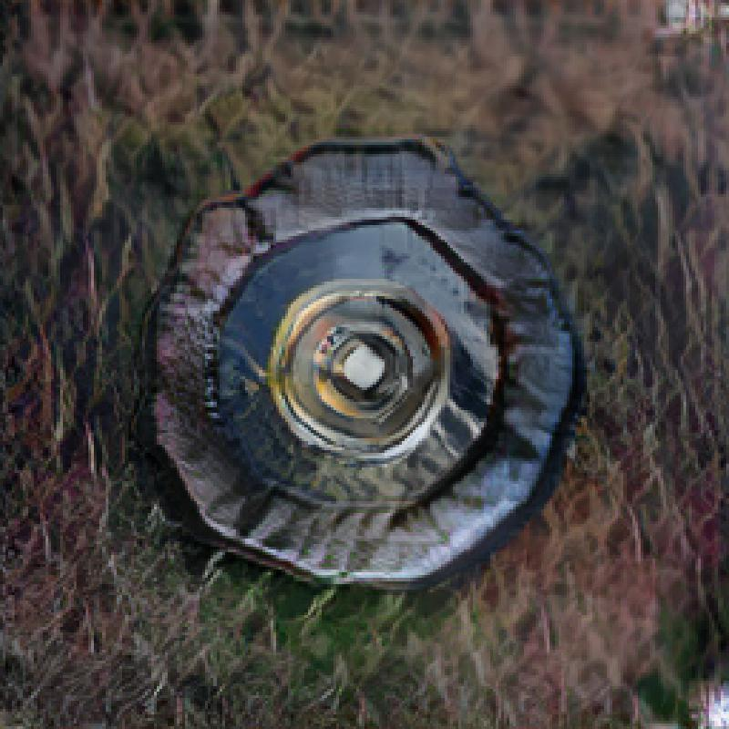

Slide 20
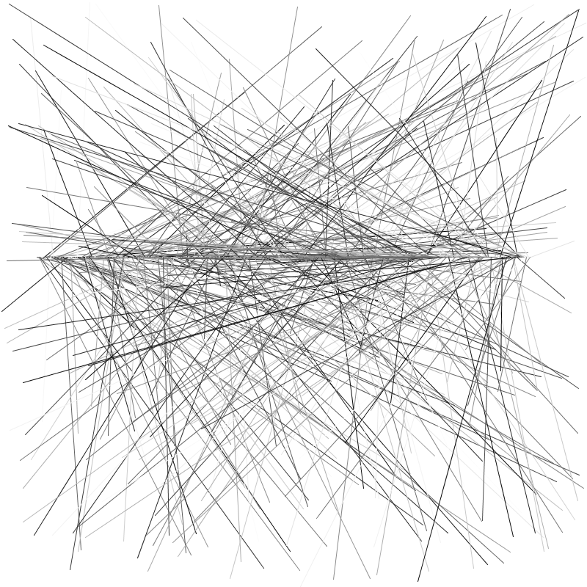
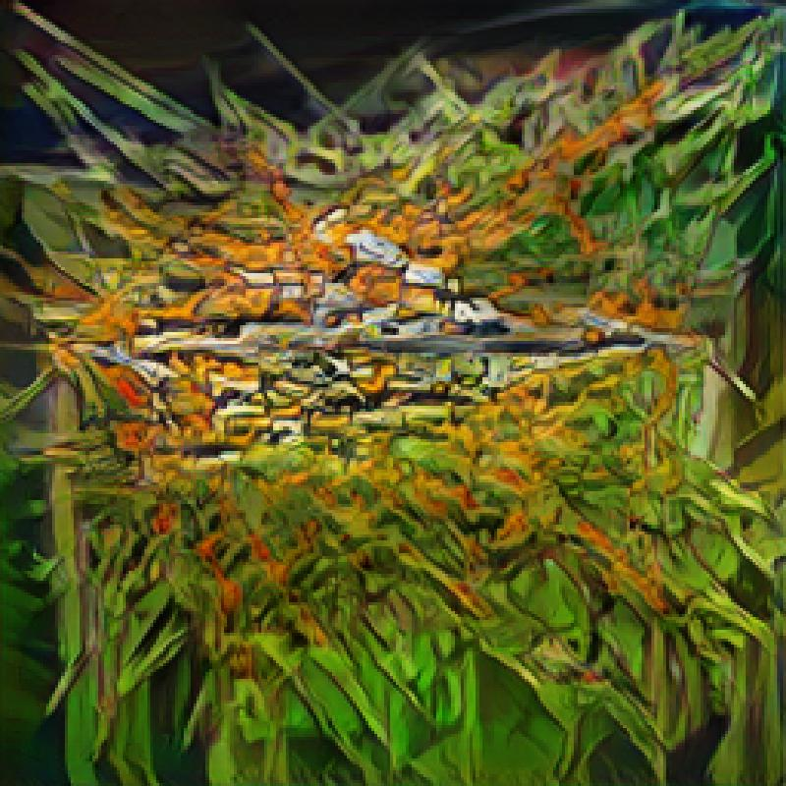
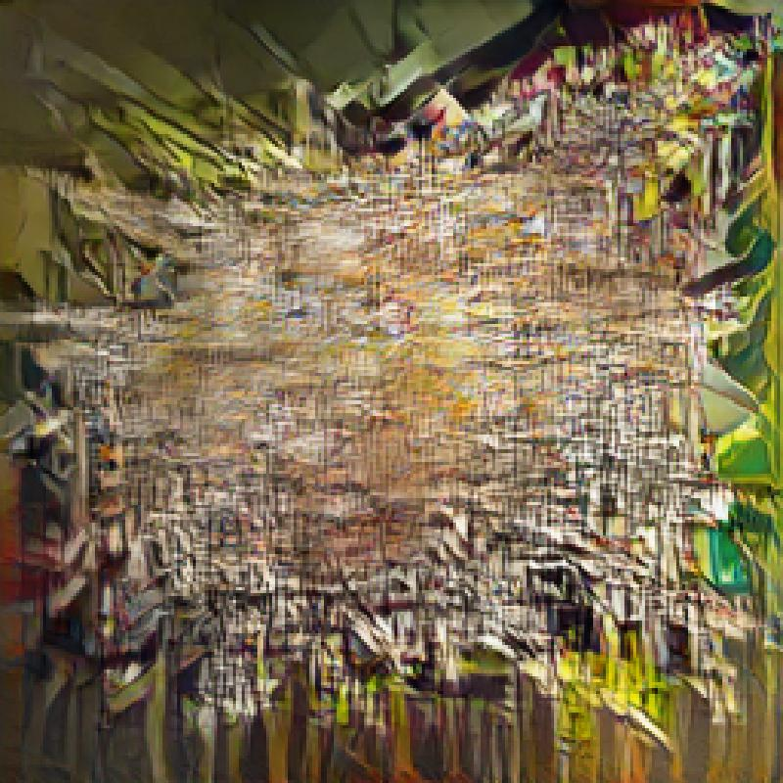
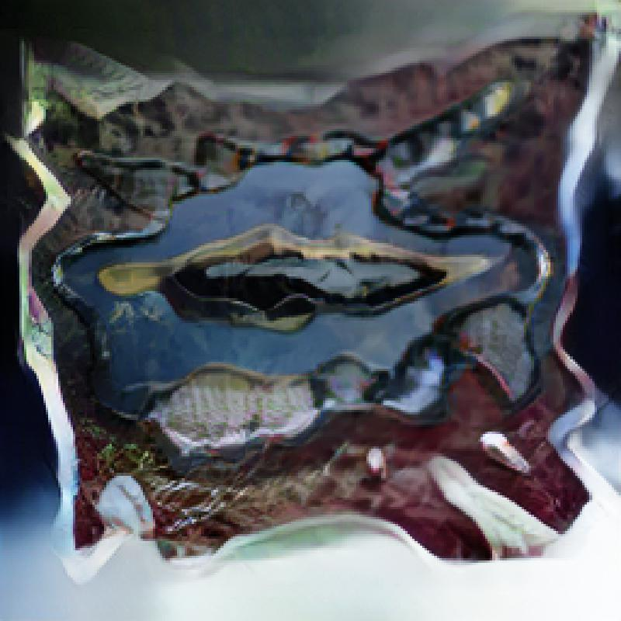

Slide 21
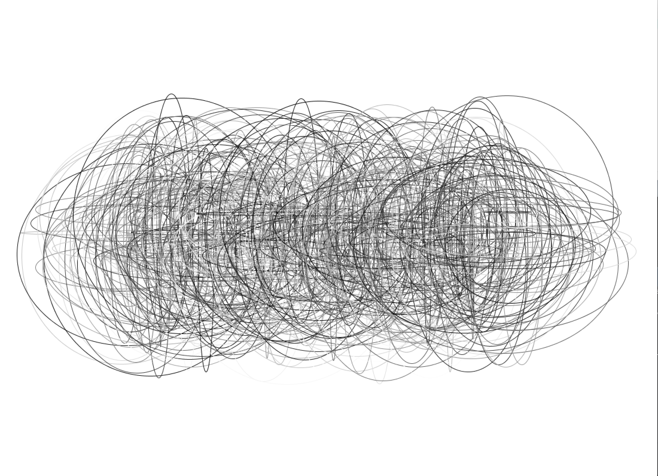
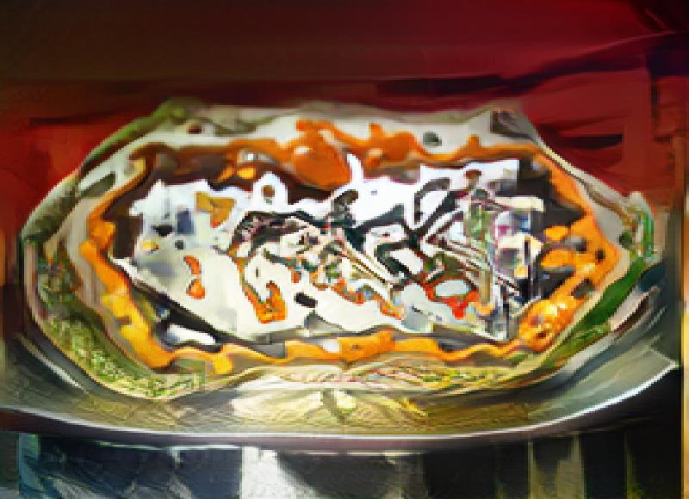
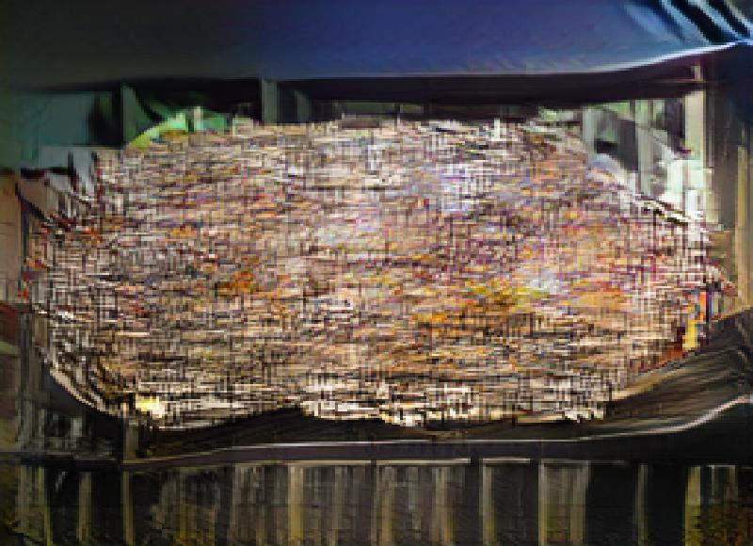
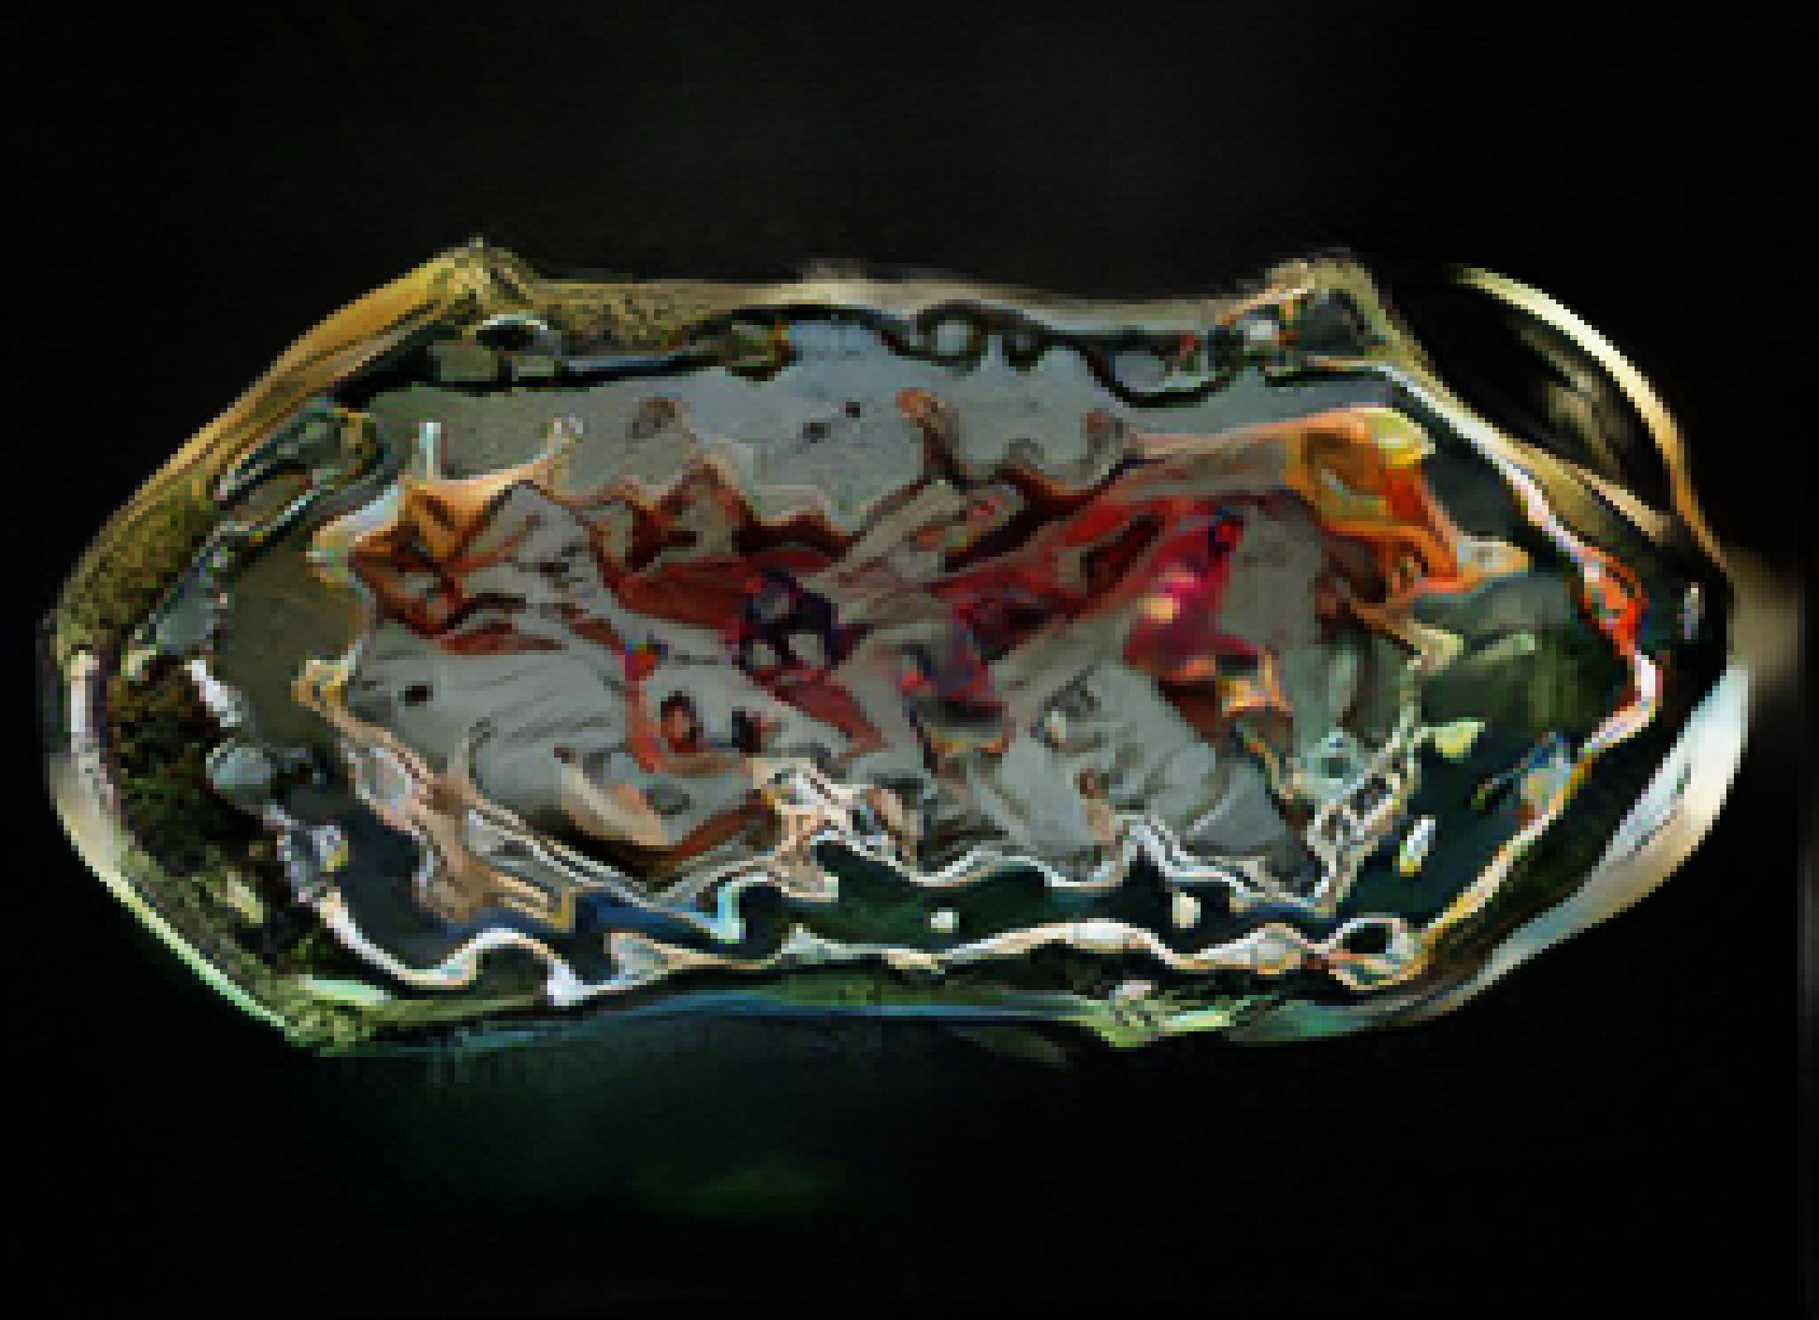

Slide 22
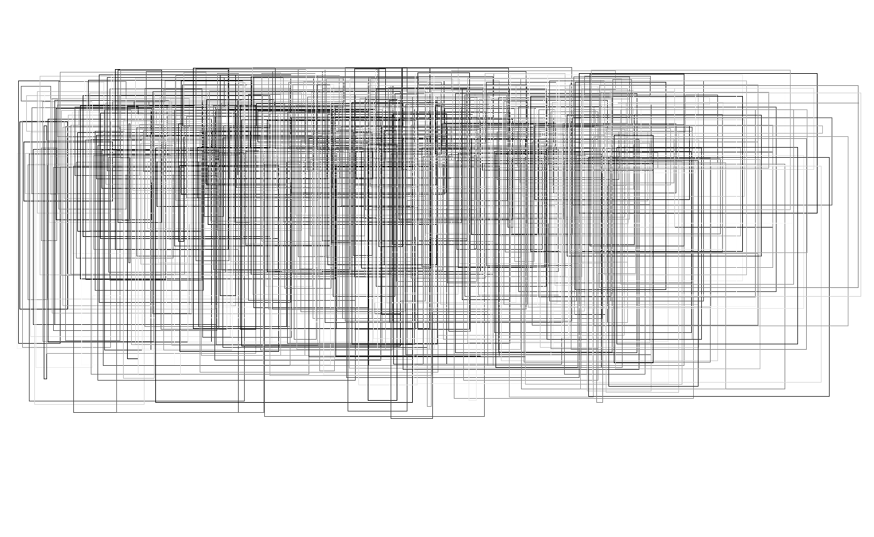




Slide 23





Slide 24





Slide 25
Conclusions/Learning Moments!
SPADE-COCO is made for abstract shapes, but!
Can still feed abstract shape input that makes the results “non-sensical” for what it was built for (instead, more of an aesthetic/design output)
Line-work (esp. mark-making) confuses the system (which makes sense, the GAN probably works with shape detection)
Coloring the shapes changes the output of the GAN
Gaussian blur:
Sometimes brings out input drawing more in output
Yields some very interesting results
Invert: works well on line drawings because it gives it more “space”
Yields some very interesting results!

